Slide 1
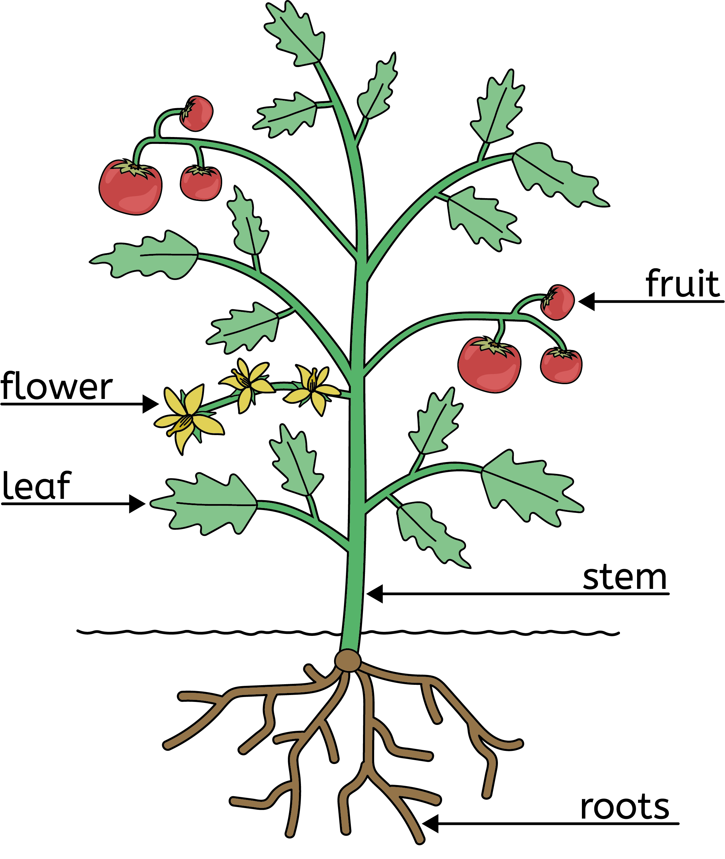
Plants
Parts of a plant
All plants have roots that take in water and nutrients for the plant.
All plants have a stem that transports water and nutrients around the plant.
All plants have leaves that are green and make food for the plant.
Some plants have flowers. They can be bright colours to attract insects. Flowers help plants reproduce.
Plants are living things
Trees are a type of plant
All plants move.
All plants grow.
All plants reproduce.
All plants need nutrition (food).
A tree’s stem is called a trunk and is made of wood.
Coniferous trees keep their leaves all year round.
Deciduous trees lose their leaves in the winter.
Science | Year 1 – Autumn 1 | Knowledge Organiser
Notes:
Image – United Learning

