Slide 1
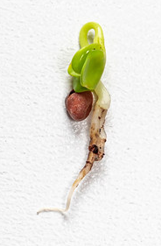
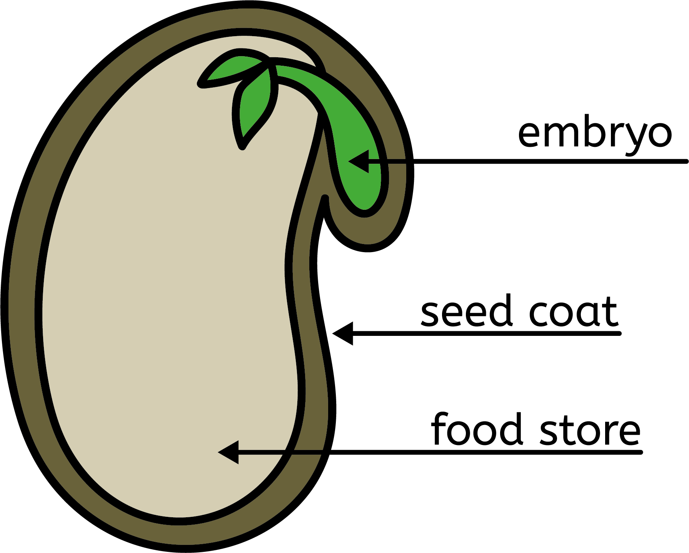
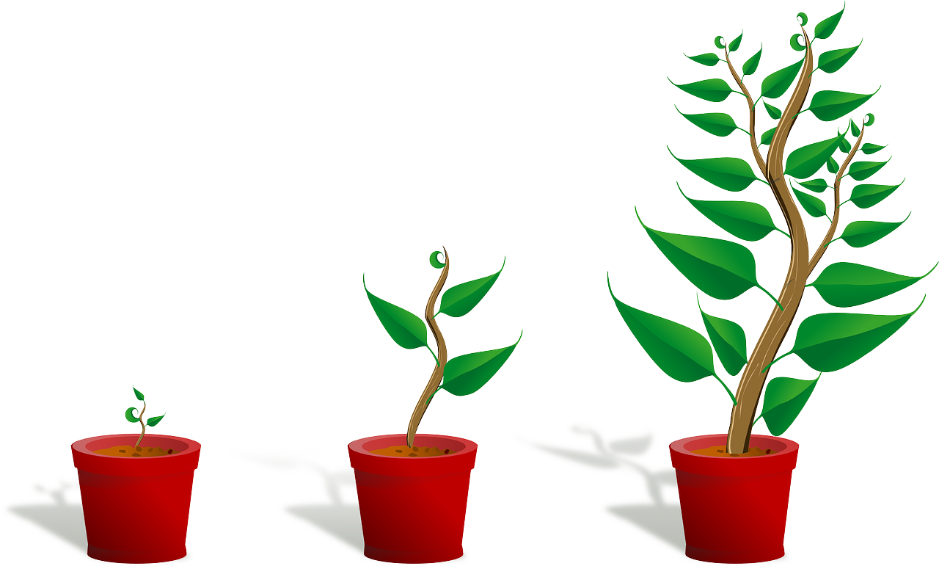
Plant growth
Seeds
Seed germination
Seeds are alive. They are dormant.
A seed is the earliest form of a plant.
Germination is where the seed starts to develop into a plant. To germinate, seeds need water and the right temperature.
The embryo is a very small plant, which has a small shoot, root and leaves.
Plant growth
The seed coat is a protective, tough layer.
To grow, plants need water, light and the right temperature. As they grow, their stem gets longer and wider. They develop more leaves.
The endosperm contains all the food the seed needs.
Growth Process Wuestenigel, CC BY 2.0, via Flickr
Science | Year 2 – Autumn 1 | Knowledge Organiser
Notes:
Seed diagram – United Learning
Growth process (CC BY 2.0) – https://www.flickr.com/photos/30478819@N08/49175687923/in/photostream/
Growing plant (CC0) – https://pixabay.com/vectors/sapling-plant-growing-seedling-154734/

