Slide 1
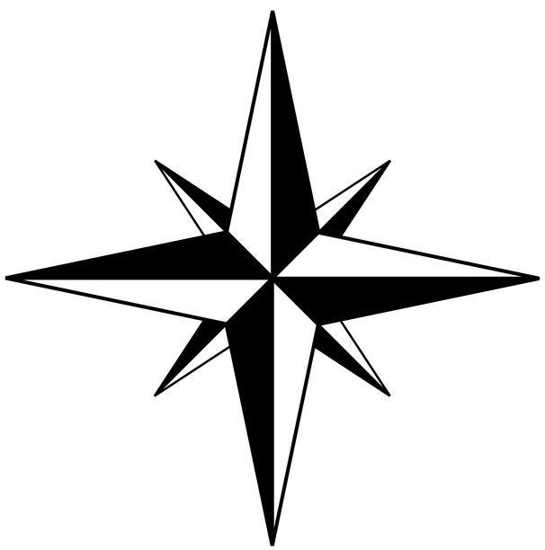













Mini Mappers
Four compass points
Using scale
Geographers use these to give directions or to locate places.
N
When geographers draw maps, they need to draw them to scale. This means:
north
west
east
W
E
objects are drawn smaller or bigger than they are in real life.
objects still look the same as they do in real life. They are just bigger or smaller.
south
S
Map symbols
Lines and symbols on a map represent real-life objects like roads, buildings, rivers and forests.
road
motorway
forest
river
visitor centre
country park
church
camp site
school
caravan site
building
Geography | Year 2 – Autumn | Knowledge Organiser
Notes:
Compass (CC0) – https://pixabay.com/fr/vectors/boussole-nord-sud-est-ouest-160863/
All other images – United Learning

