Slide 1
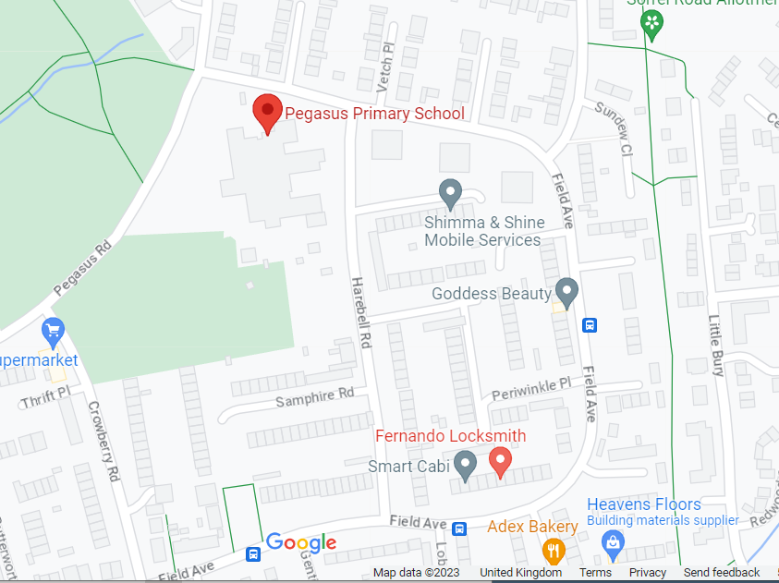
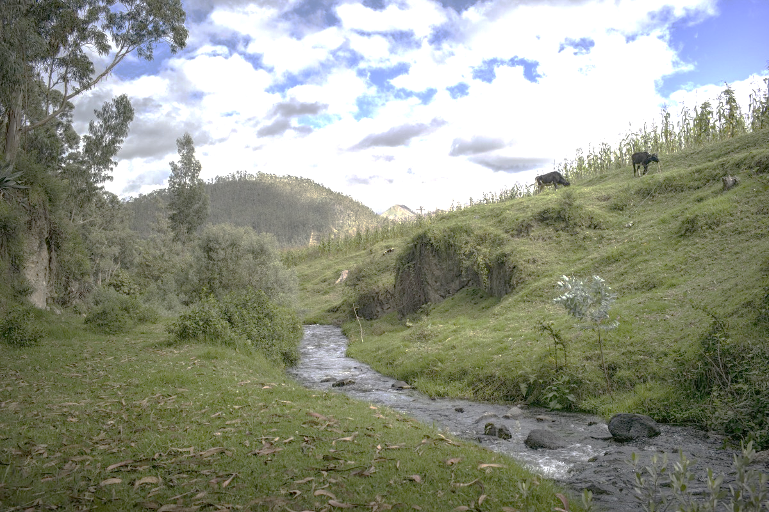
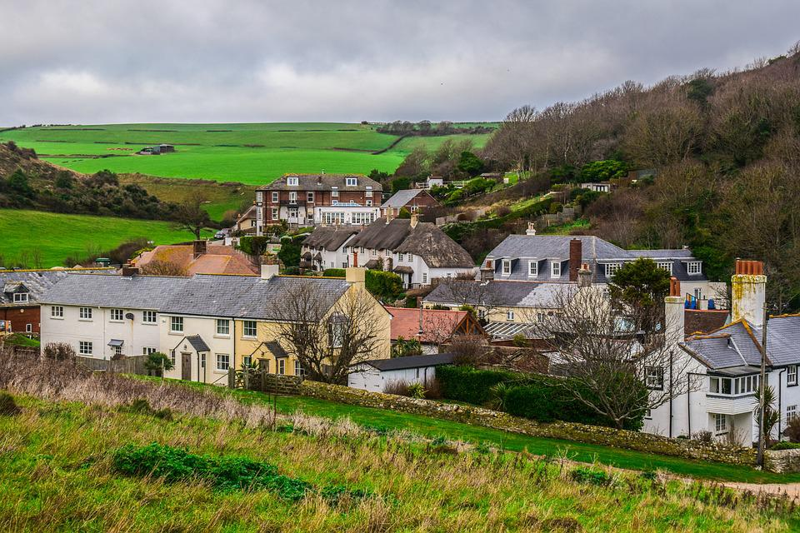
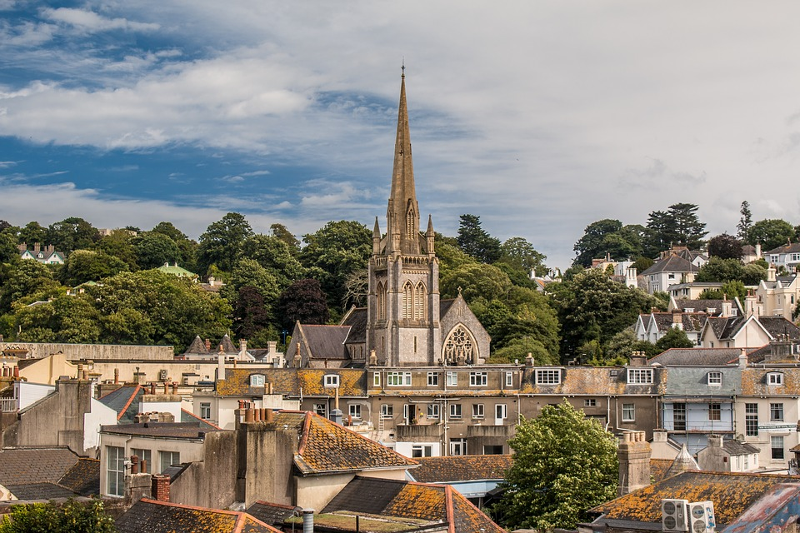
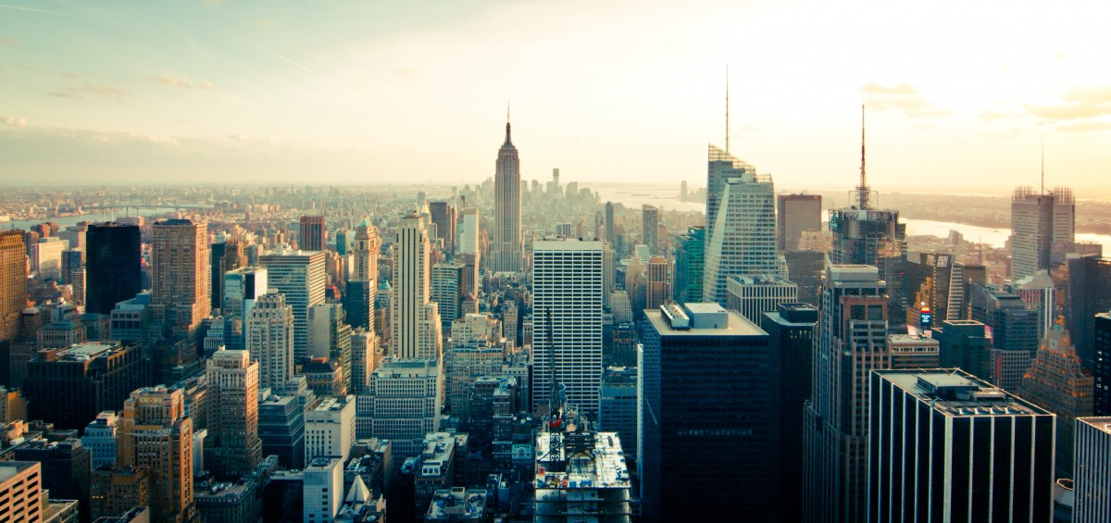
Here I Am
A map can show us the features of our local area.
Physical features…
…are things around us that are natural. They have not been made or put there by humans.
Human features…
…are things around us that are man made. They have been built by humans, like a shop, office or a house.
Human settlements can be villages, towns or cities.
hill
forest
soil (under grass)
river
village
town
city
Google Maps (2024) Pegasus Primary School, Oxford
Geography | Year 1 – Autumn | Knowledge Organiser
Notes:
Hill (CC0) – https://pxhere.com/en/photo/719295
Village (CC0) – https://pixabay.com/fr/photos/village-traditionnel-la-campagne-6787199/
Town (CC0) – https://pixabay.com/fr/photos/angleterre-ville-vieille-4113666/
City (CC0) – https://pxhere.com/en/photo/285
Google (2024), Pegasus Primary School, Oxford, 51.723639103316884, -1.185901442282043.
Available at: https://www.google.com/maps/place/Pegasus+Primary+School/@51.7212797,-1.1952248,17z/data=!4m6!3m5!1s0x4876c054d456e0bb:0x85e29582ad8f694f!8m2!3d51.7211335!4d-1.1928966!16s%2Fg%2F1tdwplfc?entry=ttu (Accessed: 16.08.2024).

Slide 2
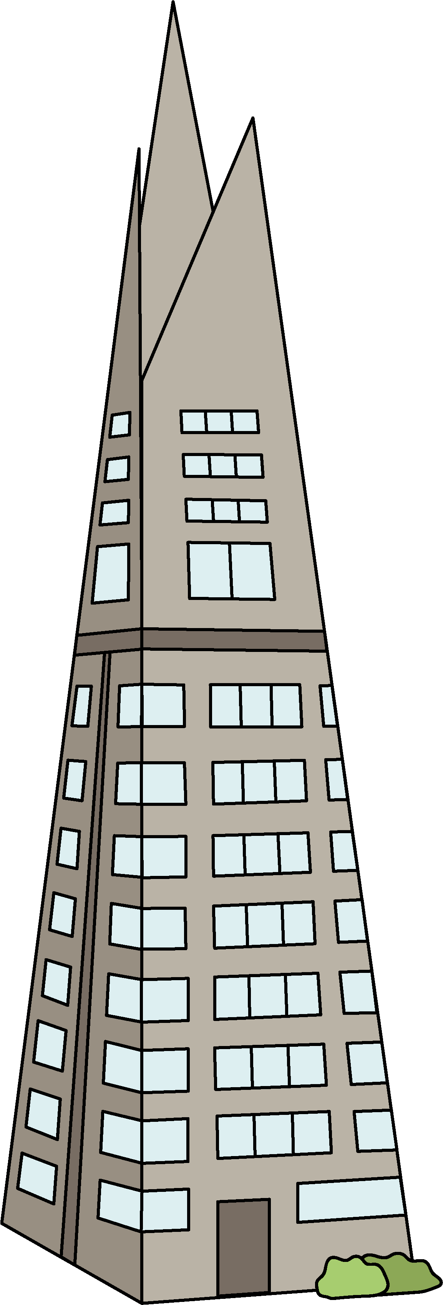
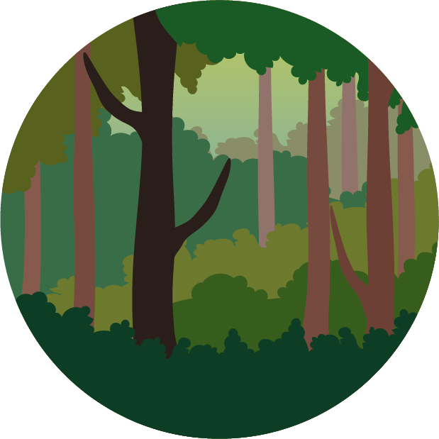
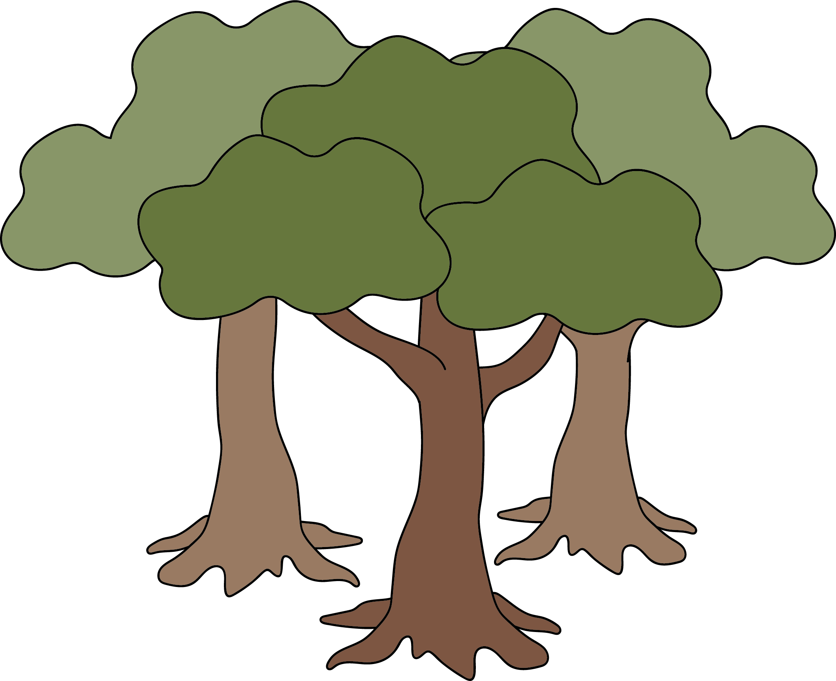
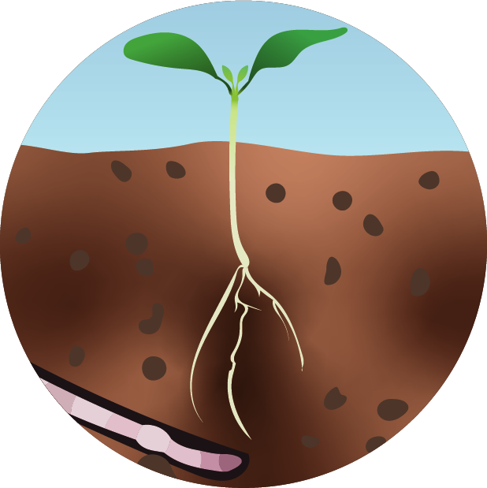
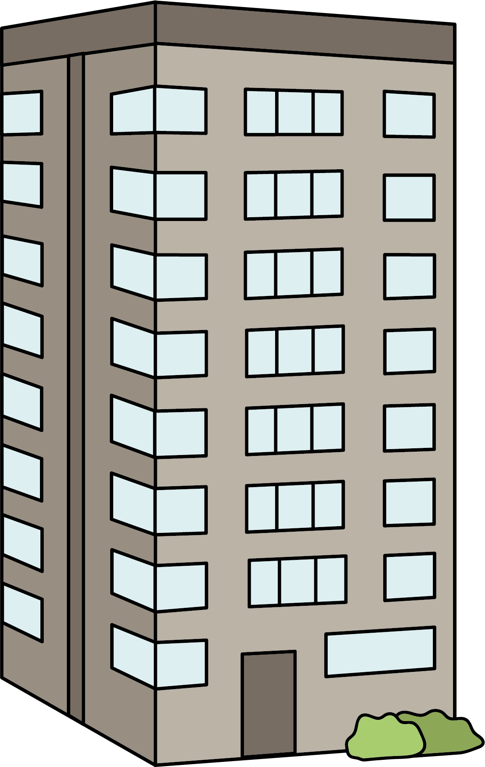
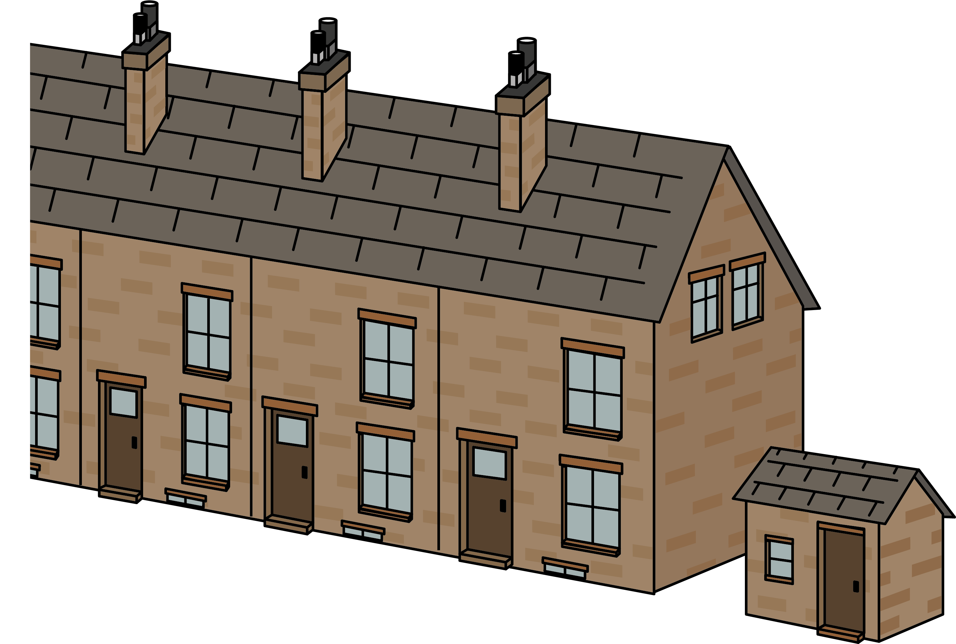


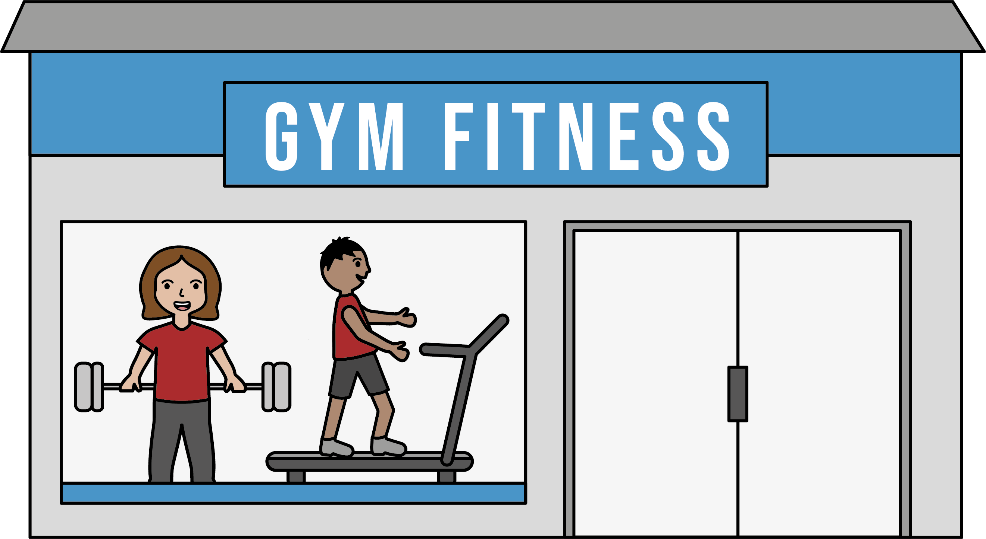
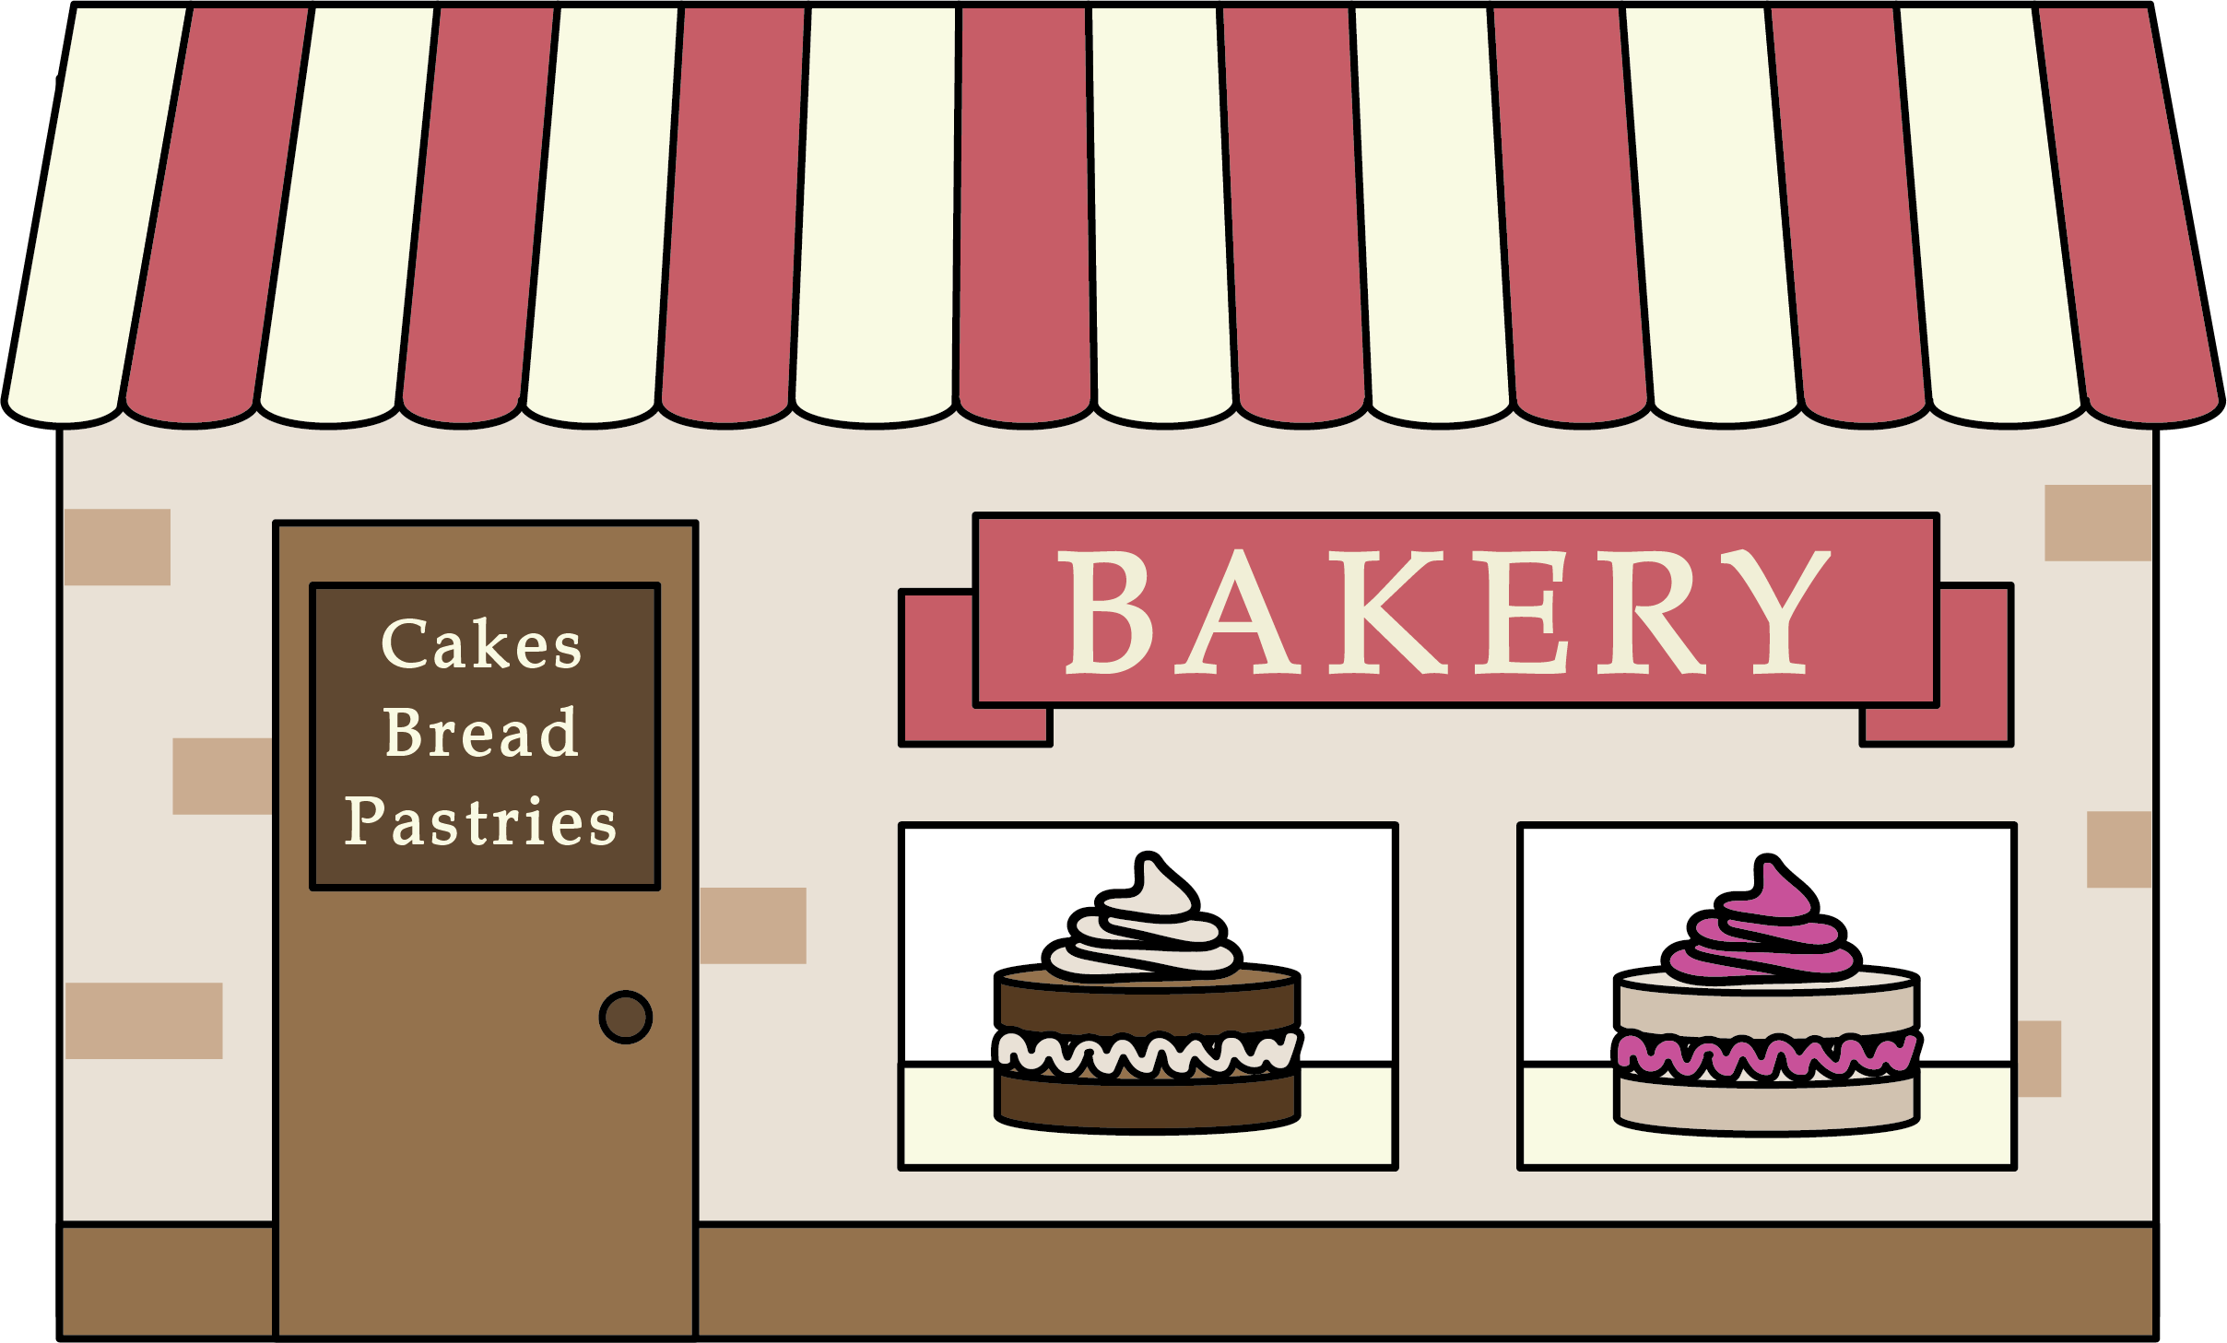
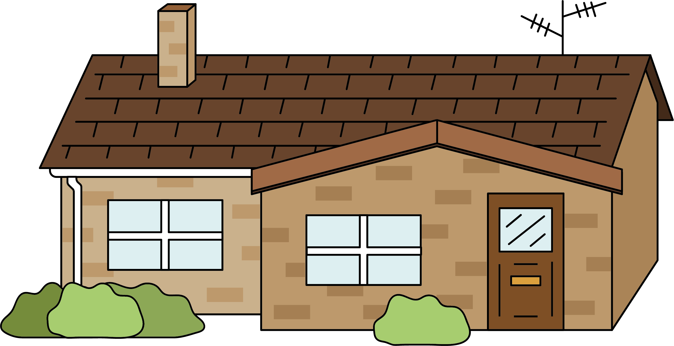
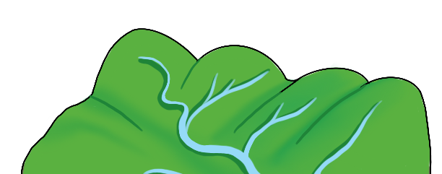
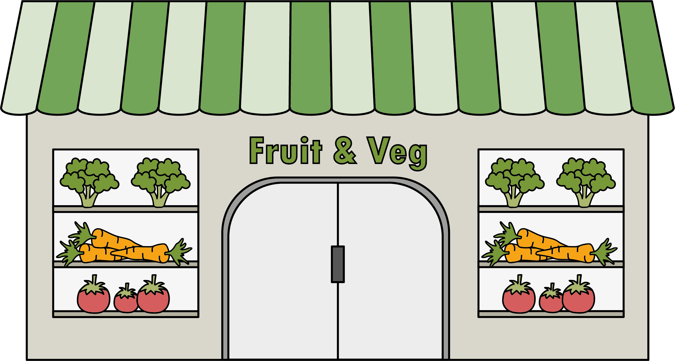
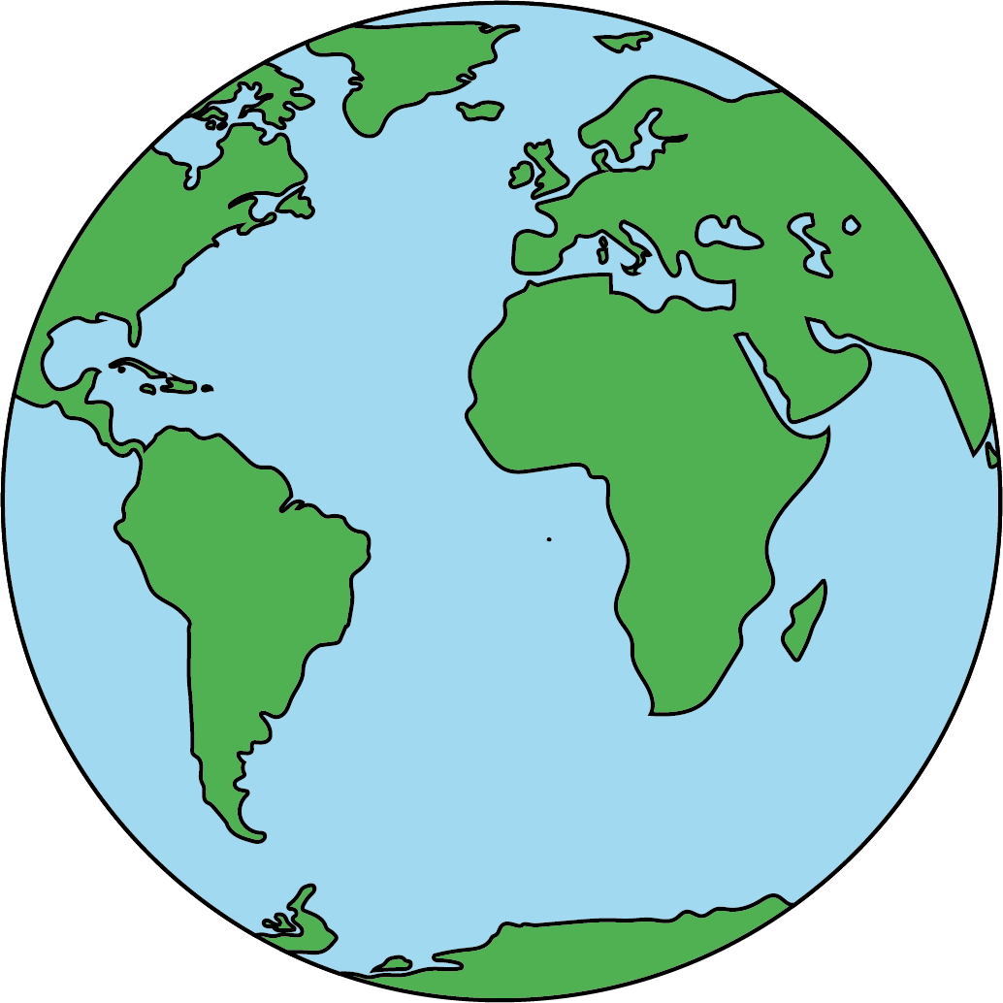
Here I Am (Key Vocabulary)
Human features:
Physical features:
forest
soil
hill
river
city
town
village
settlements
Other:
office
shop
house
left
right
Earth
office
Geography | Year 1 – Autumn | Knowledge Organiser
Notes:
All images – United Learning

