Slide 1




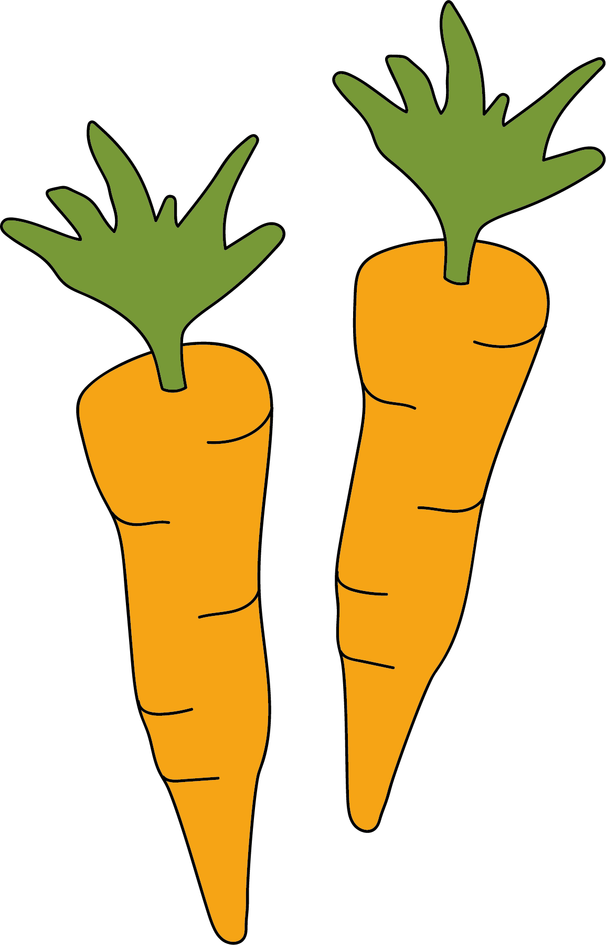
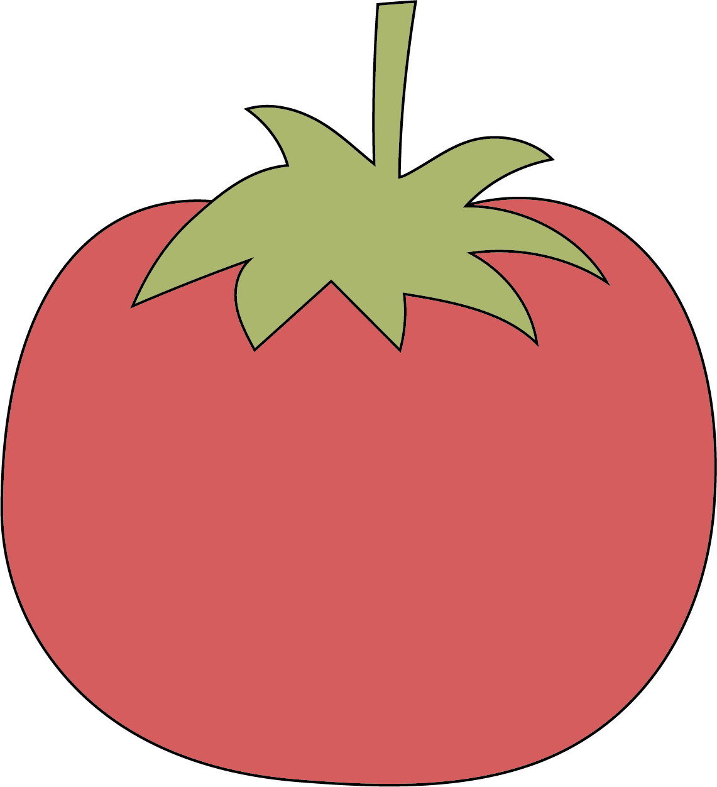
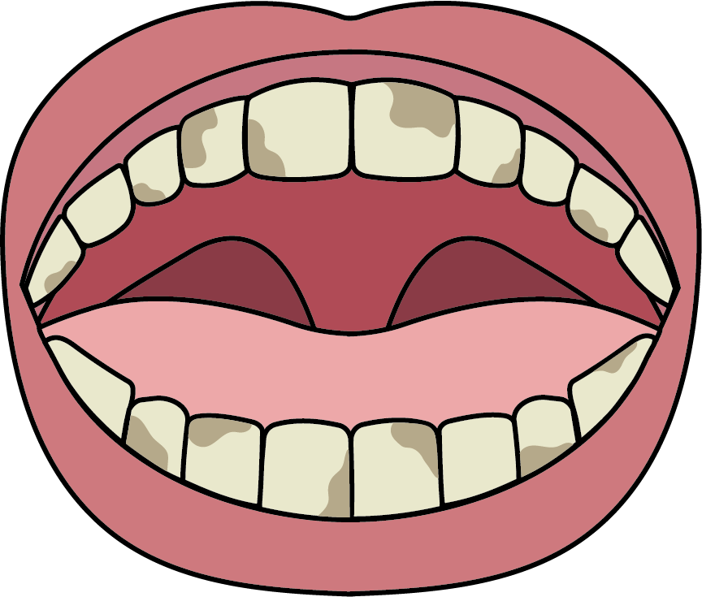
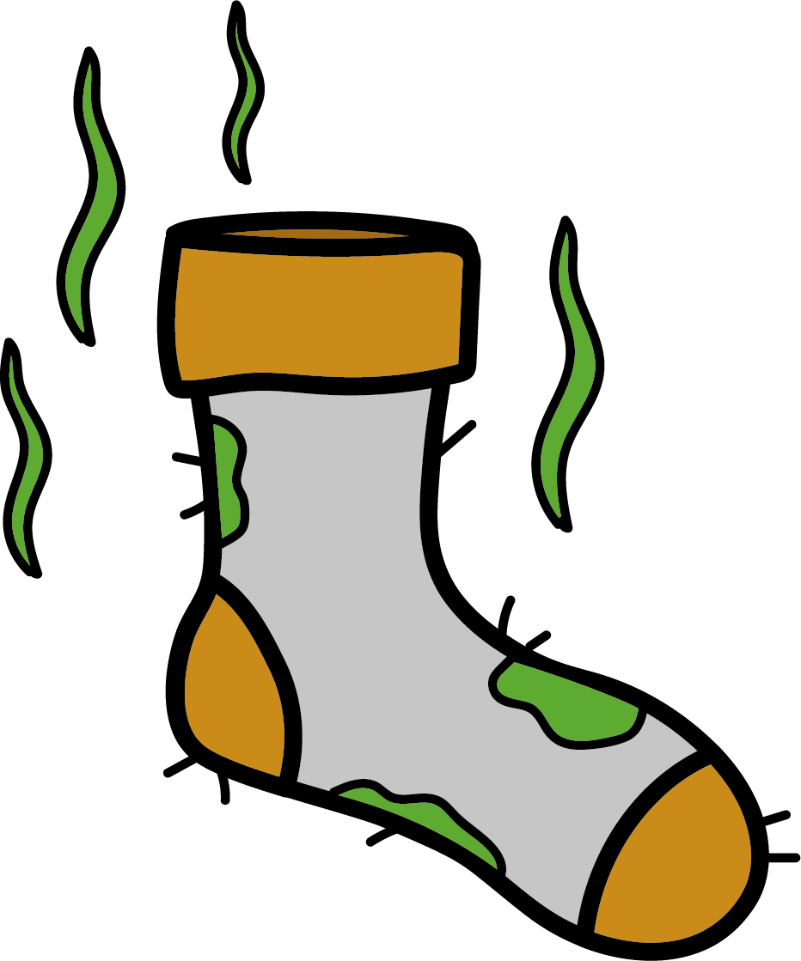

Needs of animals
To survive, all animals – including humans – need…
food
oxygen
Animals need to eat to grow, get energy to move and repair.
Some animals get oxygen by breathing air. Others get it from the water through gills.
water
Animals get water by drinking and eating food. They lose it in sweat, urine and tears.
the right temperature
Some like it hot, and some like it cold!
To stay healthy, humans need…
… a healthy, balanced diet.
Our diet should contain all the nutrients we need and be low in sugar, salt and fat.
… to practise personal hygiene.
brush teeth twice a day
change socks and underwear every day
wash hands and bodies regularly
… to get enough exercise.
Exercise helps us maintain a healthy weight, makes our muscles and bones strong and helps us sleep and feel better.
We should exercise for 60 minutes a day.
Science | Year 2 – Autumn 2 | Knowledge Organiser
Notes:
Wind, water drop, thermometer – PowerPoint icon
All other images – United Learning

