Slide 1


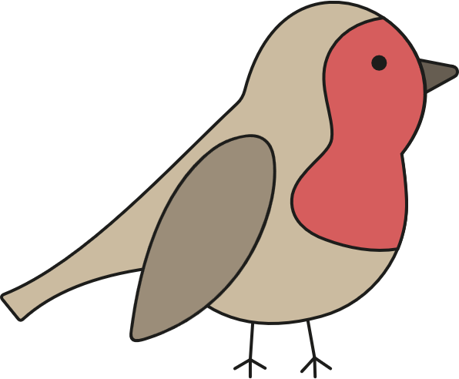
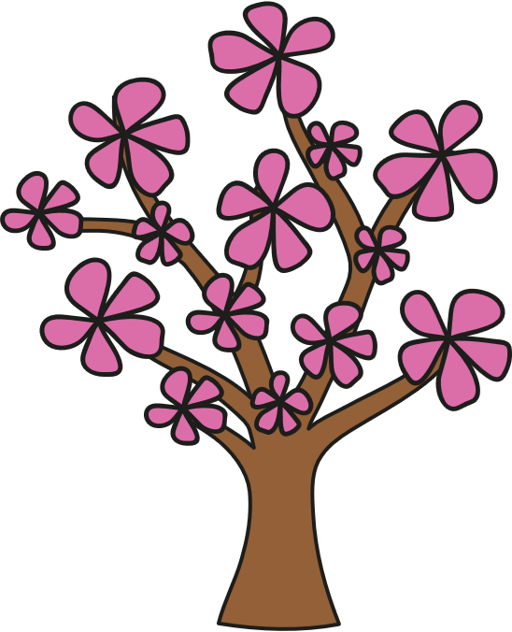










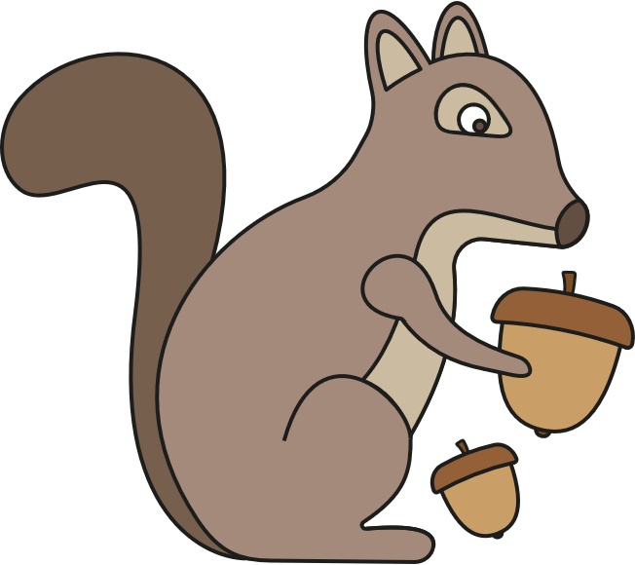





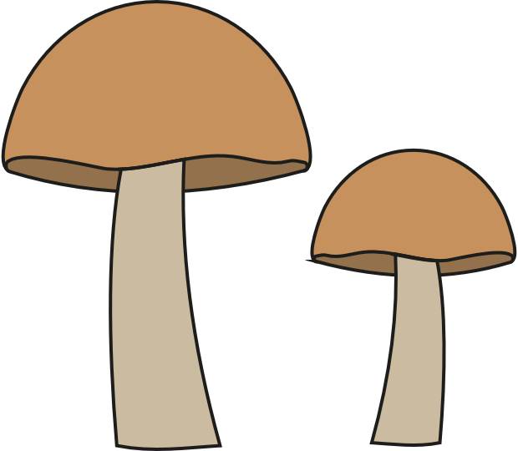

Seasonal Changes
Four seasons every year
winter
spring
It is cold, rainy and can be snowy. Deciduous trees have no leaves. Some animals hibernate.
It is warm but there can be lots of rain. Lots of flowers grow and young animals are born.
autumn
summer
It is cool, rainy and can be windy. Animals prepare for winter and leaves turn brown on deciduous trees.
It is hot and dry. Plants grow quickly and we see lots of plants and animals.
Day and Night
Sun
The Earth rotates (spins). Daytime is when we are facing the Sun. Nighttime is when we are facing away from the
Sun. In the summer, there are more hours of daylight.
night
daytime
Science | Year 1 – Autumn 2 | Knowledge Organiser
Notes:
All images – United Learning

