Slide 1
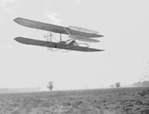
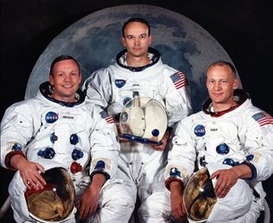
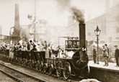
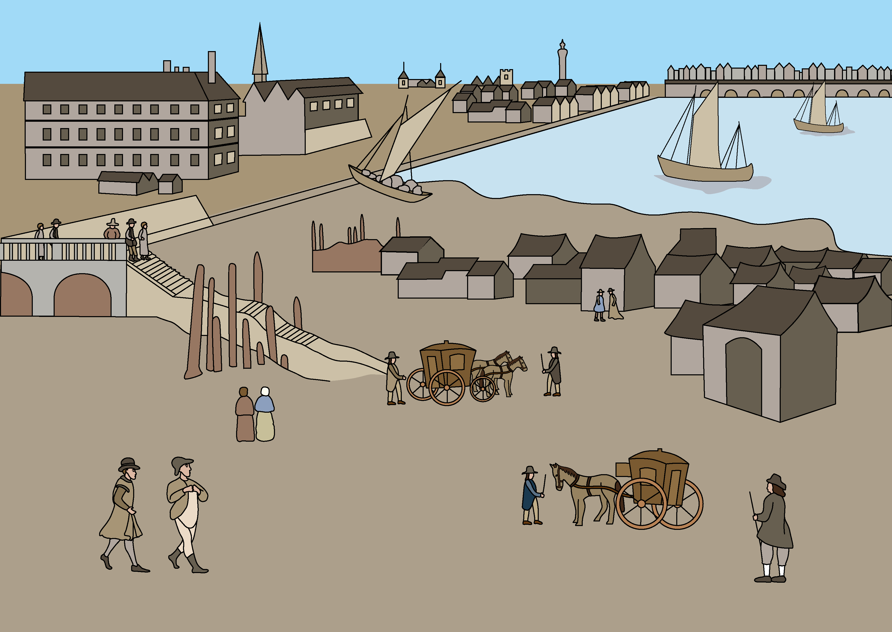
History of transport
On slides 2 & 3 there are more detailed knowledge organisers. Teacher should select or edit as appropriate for their pupils.
Vocabulary
aeroplane: a machine with wings that can fly.
astronaut: someone who is trained to travel in space.
living memory: the times that can be remembered by people who are alive today.
locomotive: the part of a train that contains the engine, that pulls the rest of the train along.
pilot: someone who controls a plane or rocket.
recent: describing something that happened not very long ago.
source: something that tells us about the past; where we get our information about the past from.
transport: a way of moving people or things from one place to another.
History | Year 1 – Spring | Knowledge Organiser
Notes:
Wright brothers’ plane (Public Domain): https://fr.wikipedia.org/wiki/Wright_Flyer_II#/media/Fichier:1904WrightFlyer.jpg
Train Number One, July 1925 (sepia photo) - The Stapleton Collection / Bridgeman Images
Apollo 11 Crew (Public Domain): https://en.wikipedia.org/wiki/Neil_Armstrong#/media/File:Apollo_11_Prime_Crew_-_GPN-2000-001164_-_Ap11-s69-31740.jpg
Tudor transport: United Learning

Slide 2
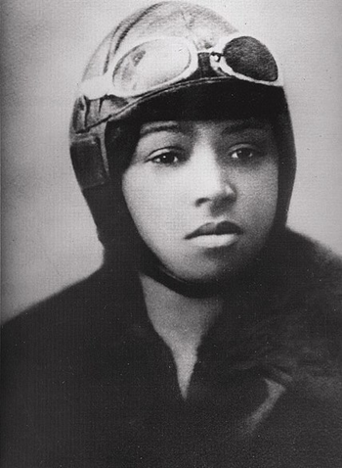
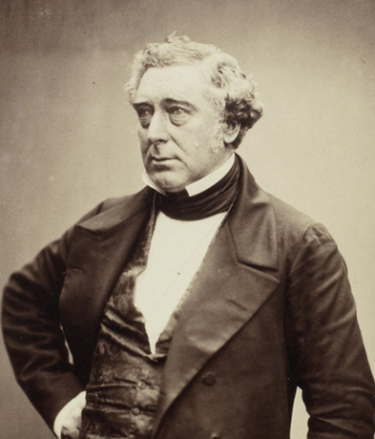
History of transport
Vocabulary
astronaut: someone who is trained to travel in space.
living memory: the times that can be remembered by people who are alive today.
recent: describing something that happened not very long ago.
source: something that tells us about the past; where we get our information about the past from.
transport: a way of moving people or things from one place to another.
Important individuals
Neil Armstrong, Buzz Aldrin and Michael Collins went on Apollo 11 – the mission to walk on the Moon.
Bessie Coleman was the first black woman to train to fly an aeroplane.
Henry Ford’s assembly line made cars more cheaply and easily.
The Wright brothers built the first aeroplane to fly.
Karl Benz built the first car.
Robert and George Stephenson built a locomotive to pull a train between Stockton and Darlington, and then the ‘Rocket’ between Manchester and Liverpool.
History | Year 1 – Spring | Knowledge Organiser
Notes:
Apollo 11 Crew (Public Domain): https://en.wikipedia.org/wiki/Neil_Armstrong#/media/File:Apollo_11_Prime_Crew_-_GPN-2000-001164_-_Ap11-s69-31740.jpg
Bessie Coleman (Public Domain): https://en.wikipedia.org/wiki/File:Bessie_Coleman,_First_African_American_Pilot_-_GPN-2004-00027.jpg
Robert Stephenson (Public Domain): https://en.wikipedia.org/wiki/Robert_Stephenson#/media/File:Robert_Stephenson_by_Maull_&_Polybank,_1856_(crop).jpg

Slide 3
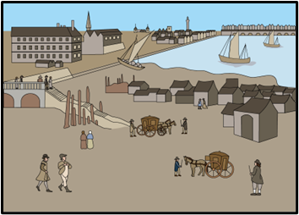
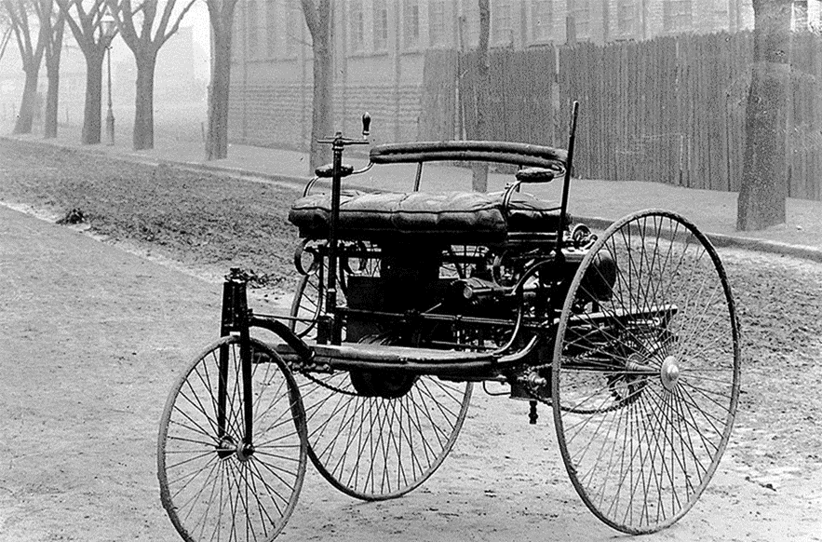
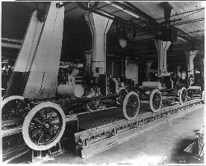
History of transport
2
4
1
6
Living memory
Now
5
3
Important individuals
Vocabulary
Neil Armstrong, Buzz Aldrin and Michael Collins went on Apollo 11 – the mission to walk on the Moon.
Bessie Coleman was the first black woman to train to fly an aeroplane.
Henry Ford’s assembly line made cars more cheaply and easily.
The Wright brothers built the first aeroplane to fly.
Karl Benz built the first car.
Robert and George Stephenson built a locomotive to pull a train between Stockton and Darlington, and then the ‘Rocket’ between Manchester and Liverpool.
aeroplane: a machine with wings that can fly.
astronaut: someone who is trained to travel in space.
living memory: the times that can be remembered by people who are alive today.
locomotive: the part of a train that contains the engine, that pulls the rest of the train along.
pilot: someone who controls a plane or rocket.
recent: describing something that happened not very long ago.
source: something that tells us about the past; where we get our information about the past from.
transport: a way of moving people or things from one place to another.
1
2
3
4
5
6
History | Year 1 – Spring | Knowledge Organiser
Notes:
Wright brothers’ plane (Public Domain): https://fr.wikipedia.org/wiki/Wright_Flyer_II#/media/Fichier:1904WrightFlyer.jpg
Train Number One, July 1925 (sepia photo) - The Stapleton Collection / Bridgeman Images
Apollo 11 Crew (Public Domain): https://en.wikipedia.org/wiki/Neil_Armstrong#/media/File:Apollo_11_Prime_Crew_-_GPN-2000-001164_-_Ap11-s69-31740.jpg
Tudor transport: United Learning
Bessie Coleman (Public Domain): https://en.wikipedia.org/wiki/File:Bessie_Coleman,_First_African_American_Pilot_-_GPN-2004-00027.jpg
Assembly line (CC0): https://picryl.com/media/assembly-line-at-the-ford-motor-companys-highland-park-plant
Benz Tri-Car (Public Domain): https://en.wikipedia.org/wiki/Carl_Benz#/media/File:1885Benz.jpg

