Slide 1
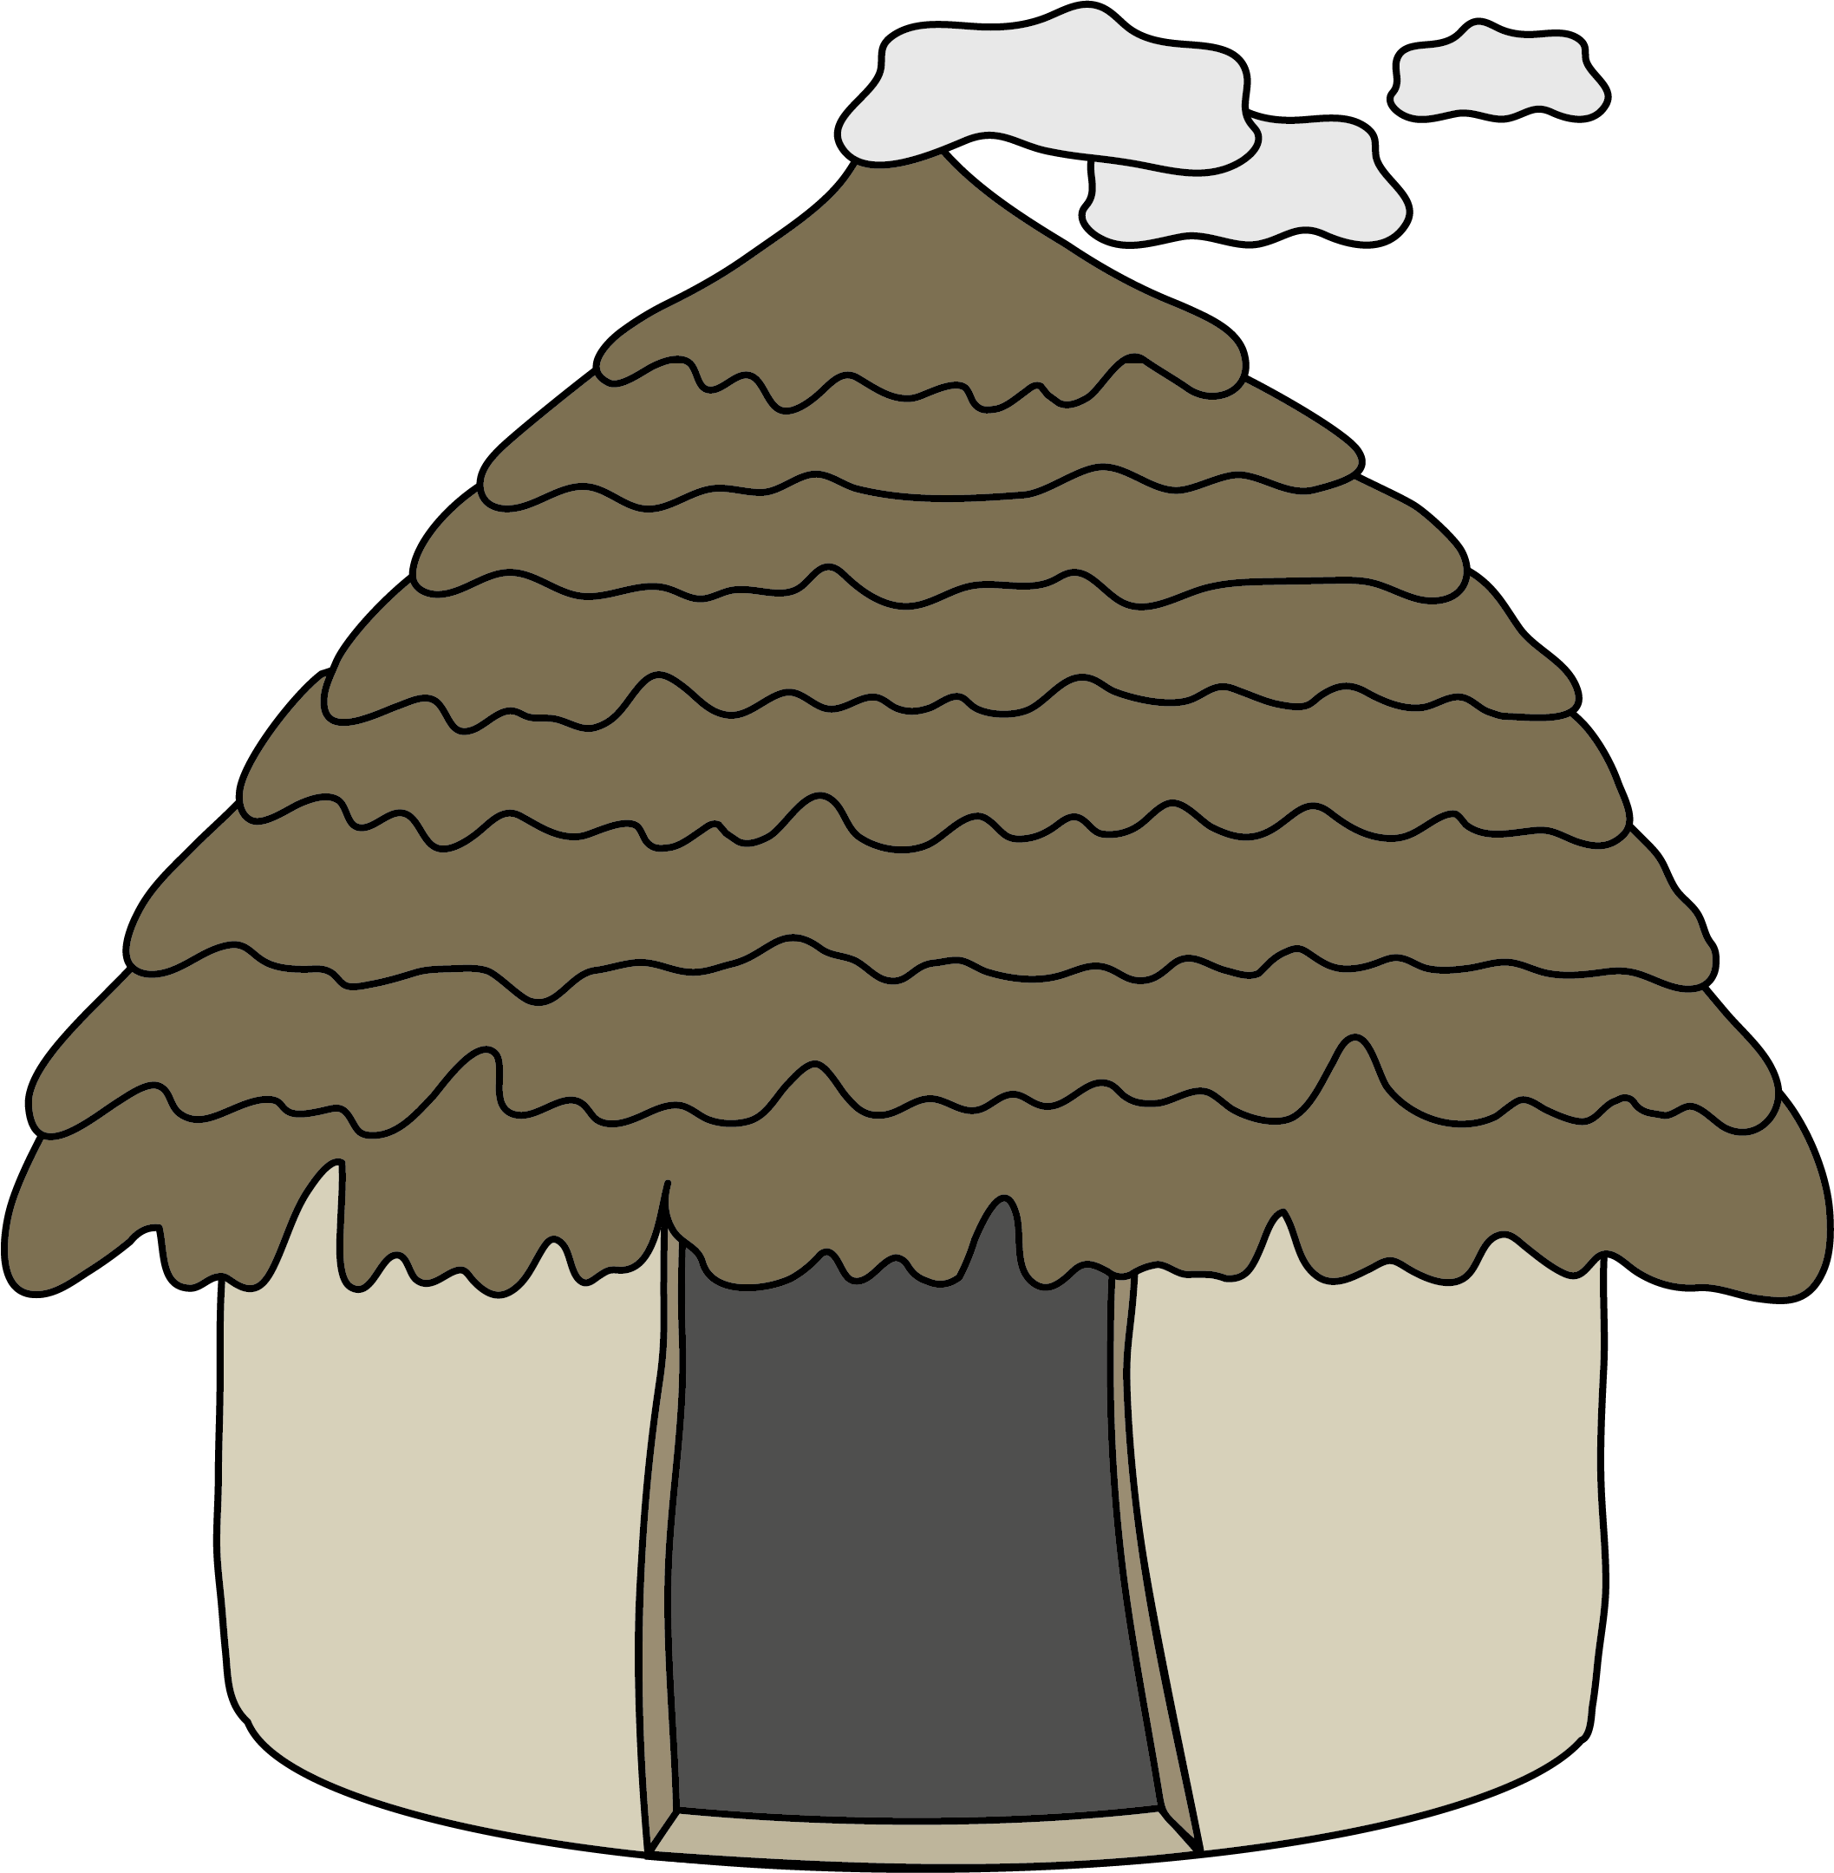
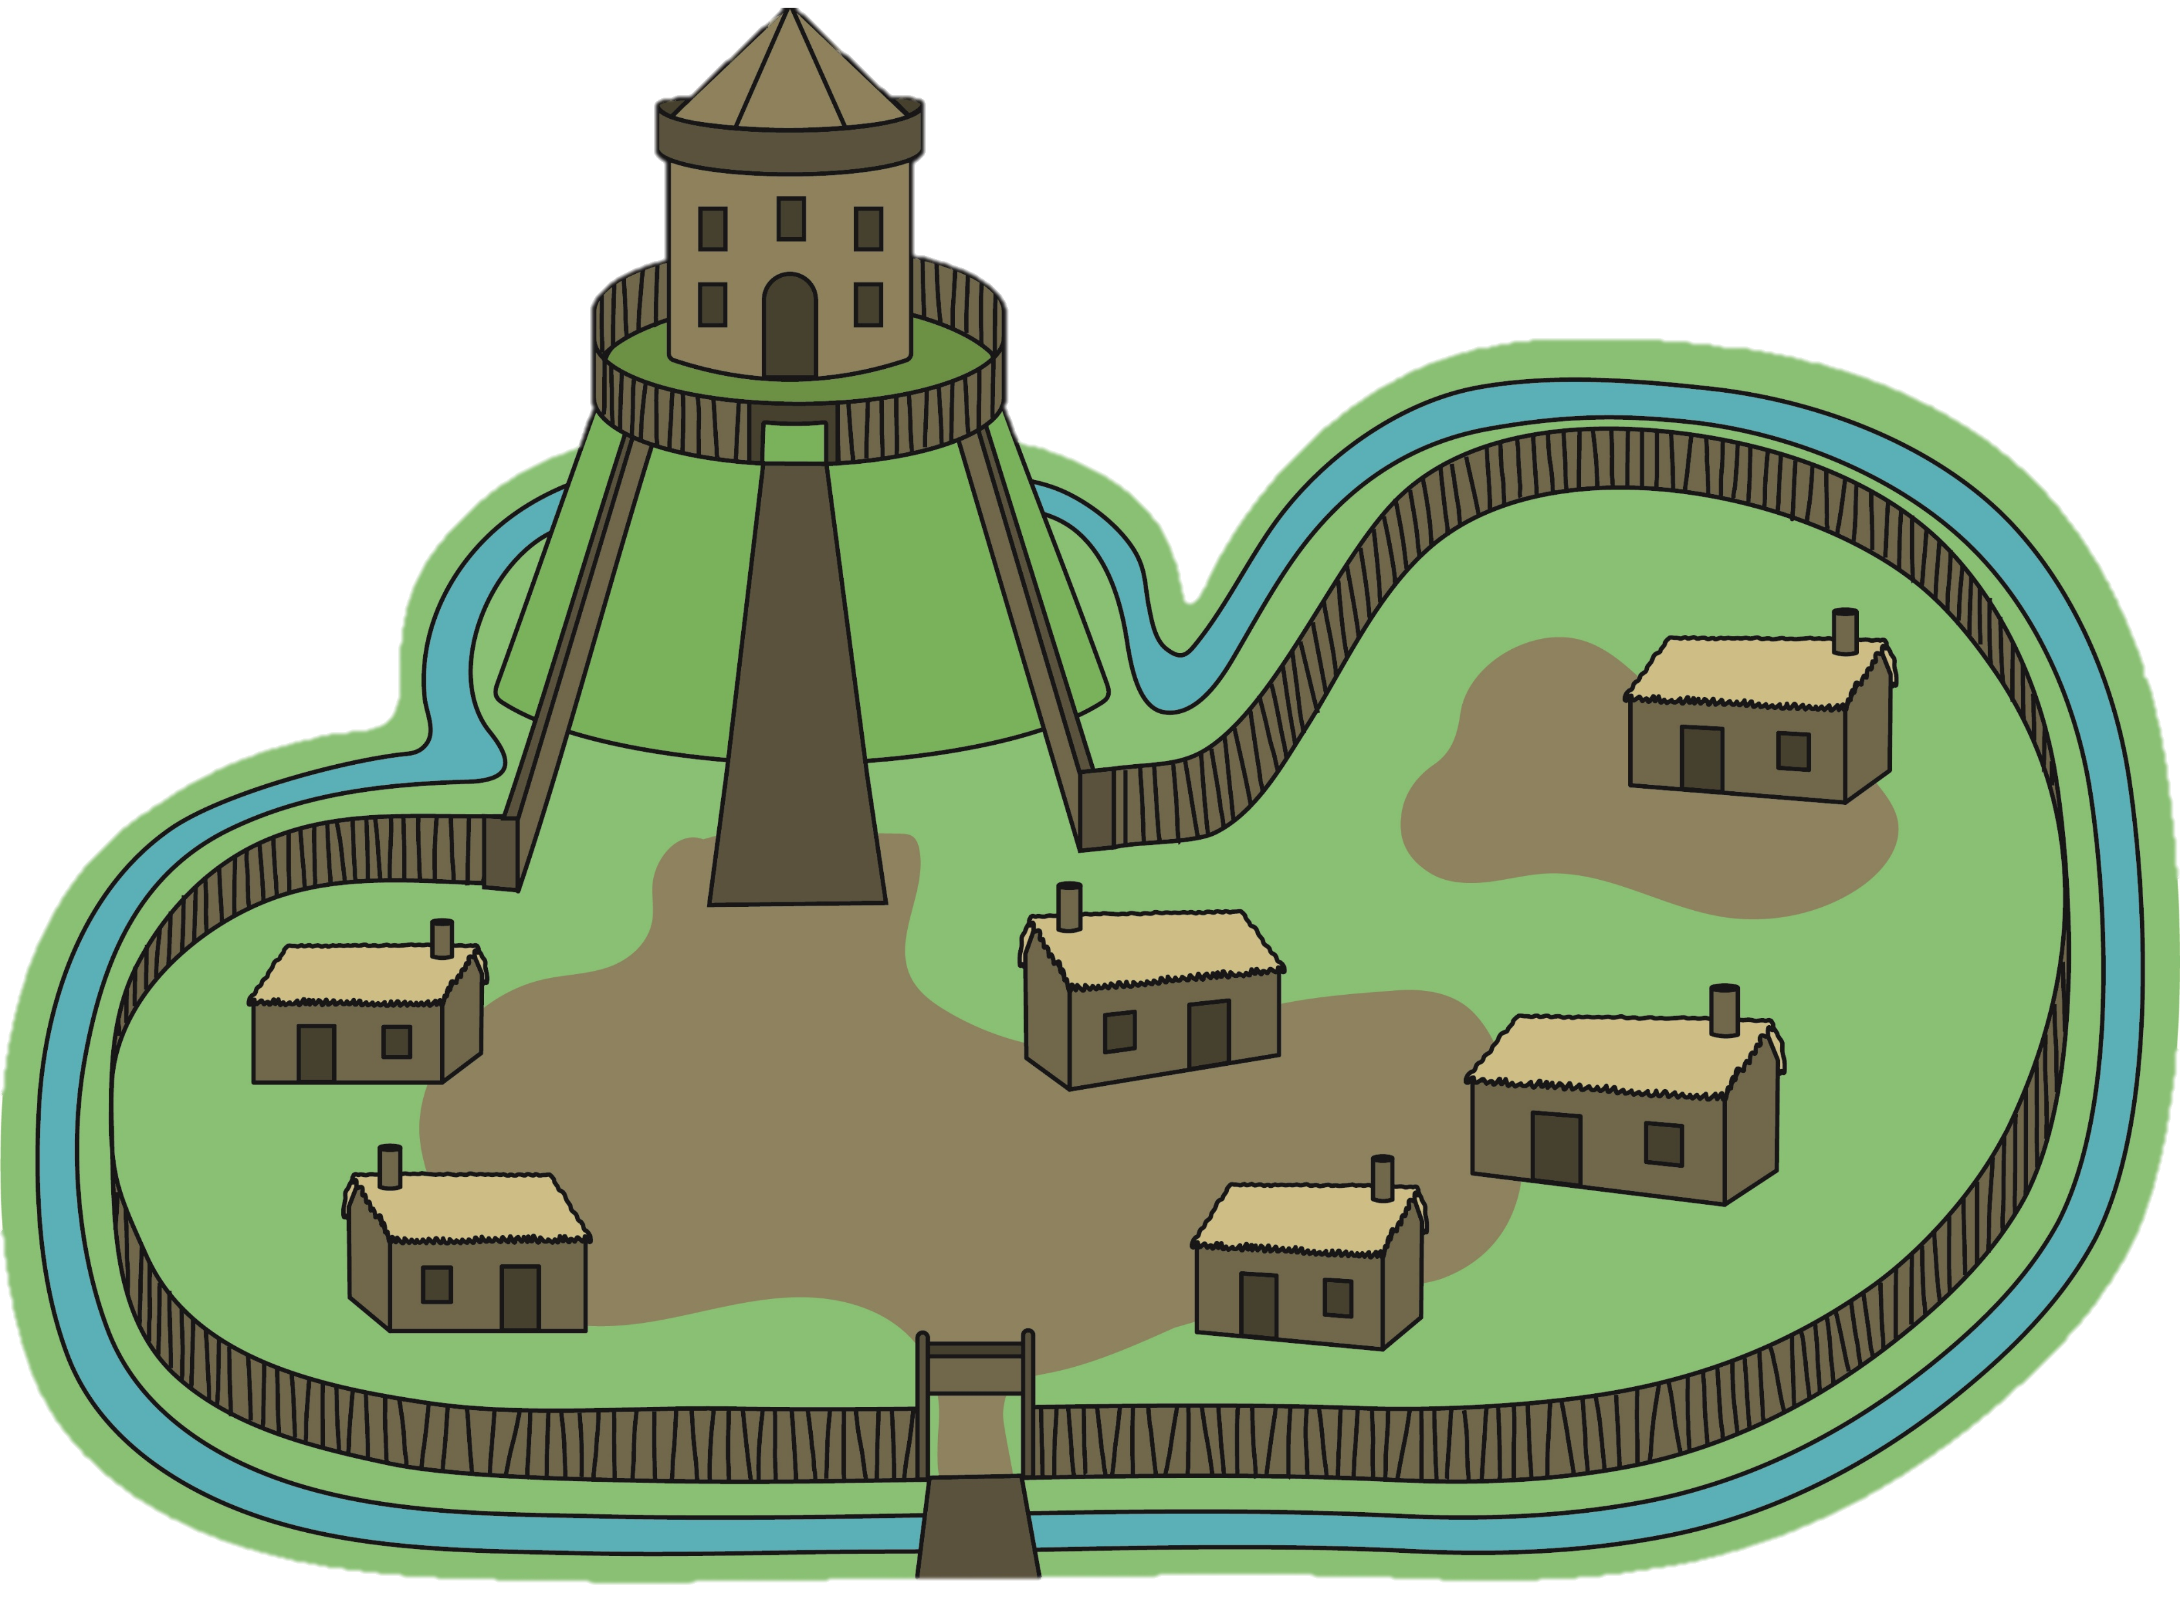
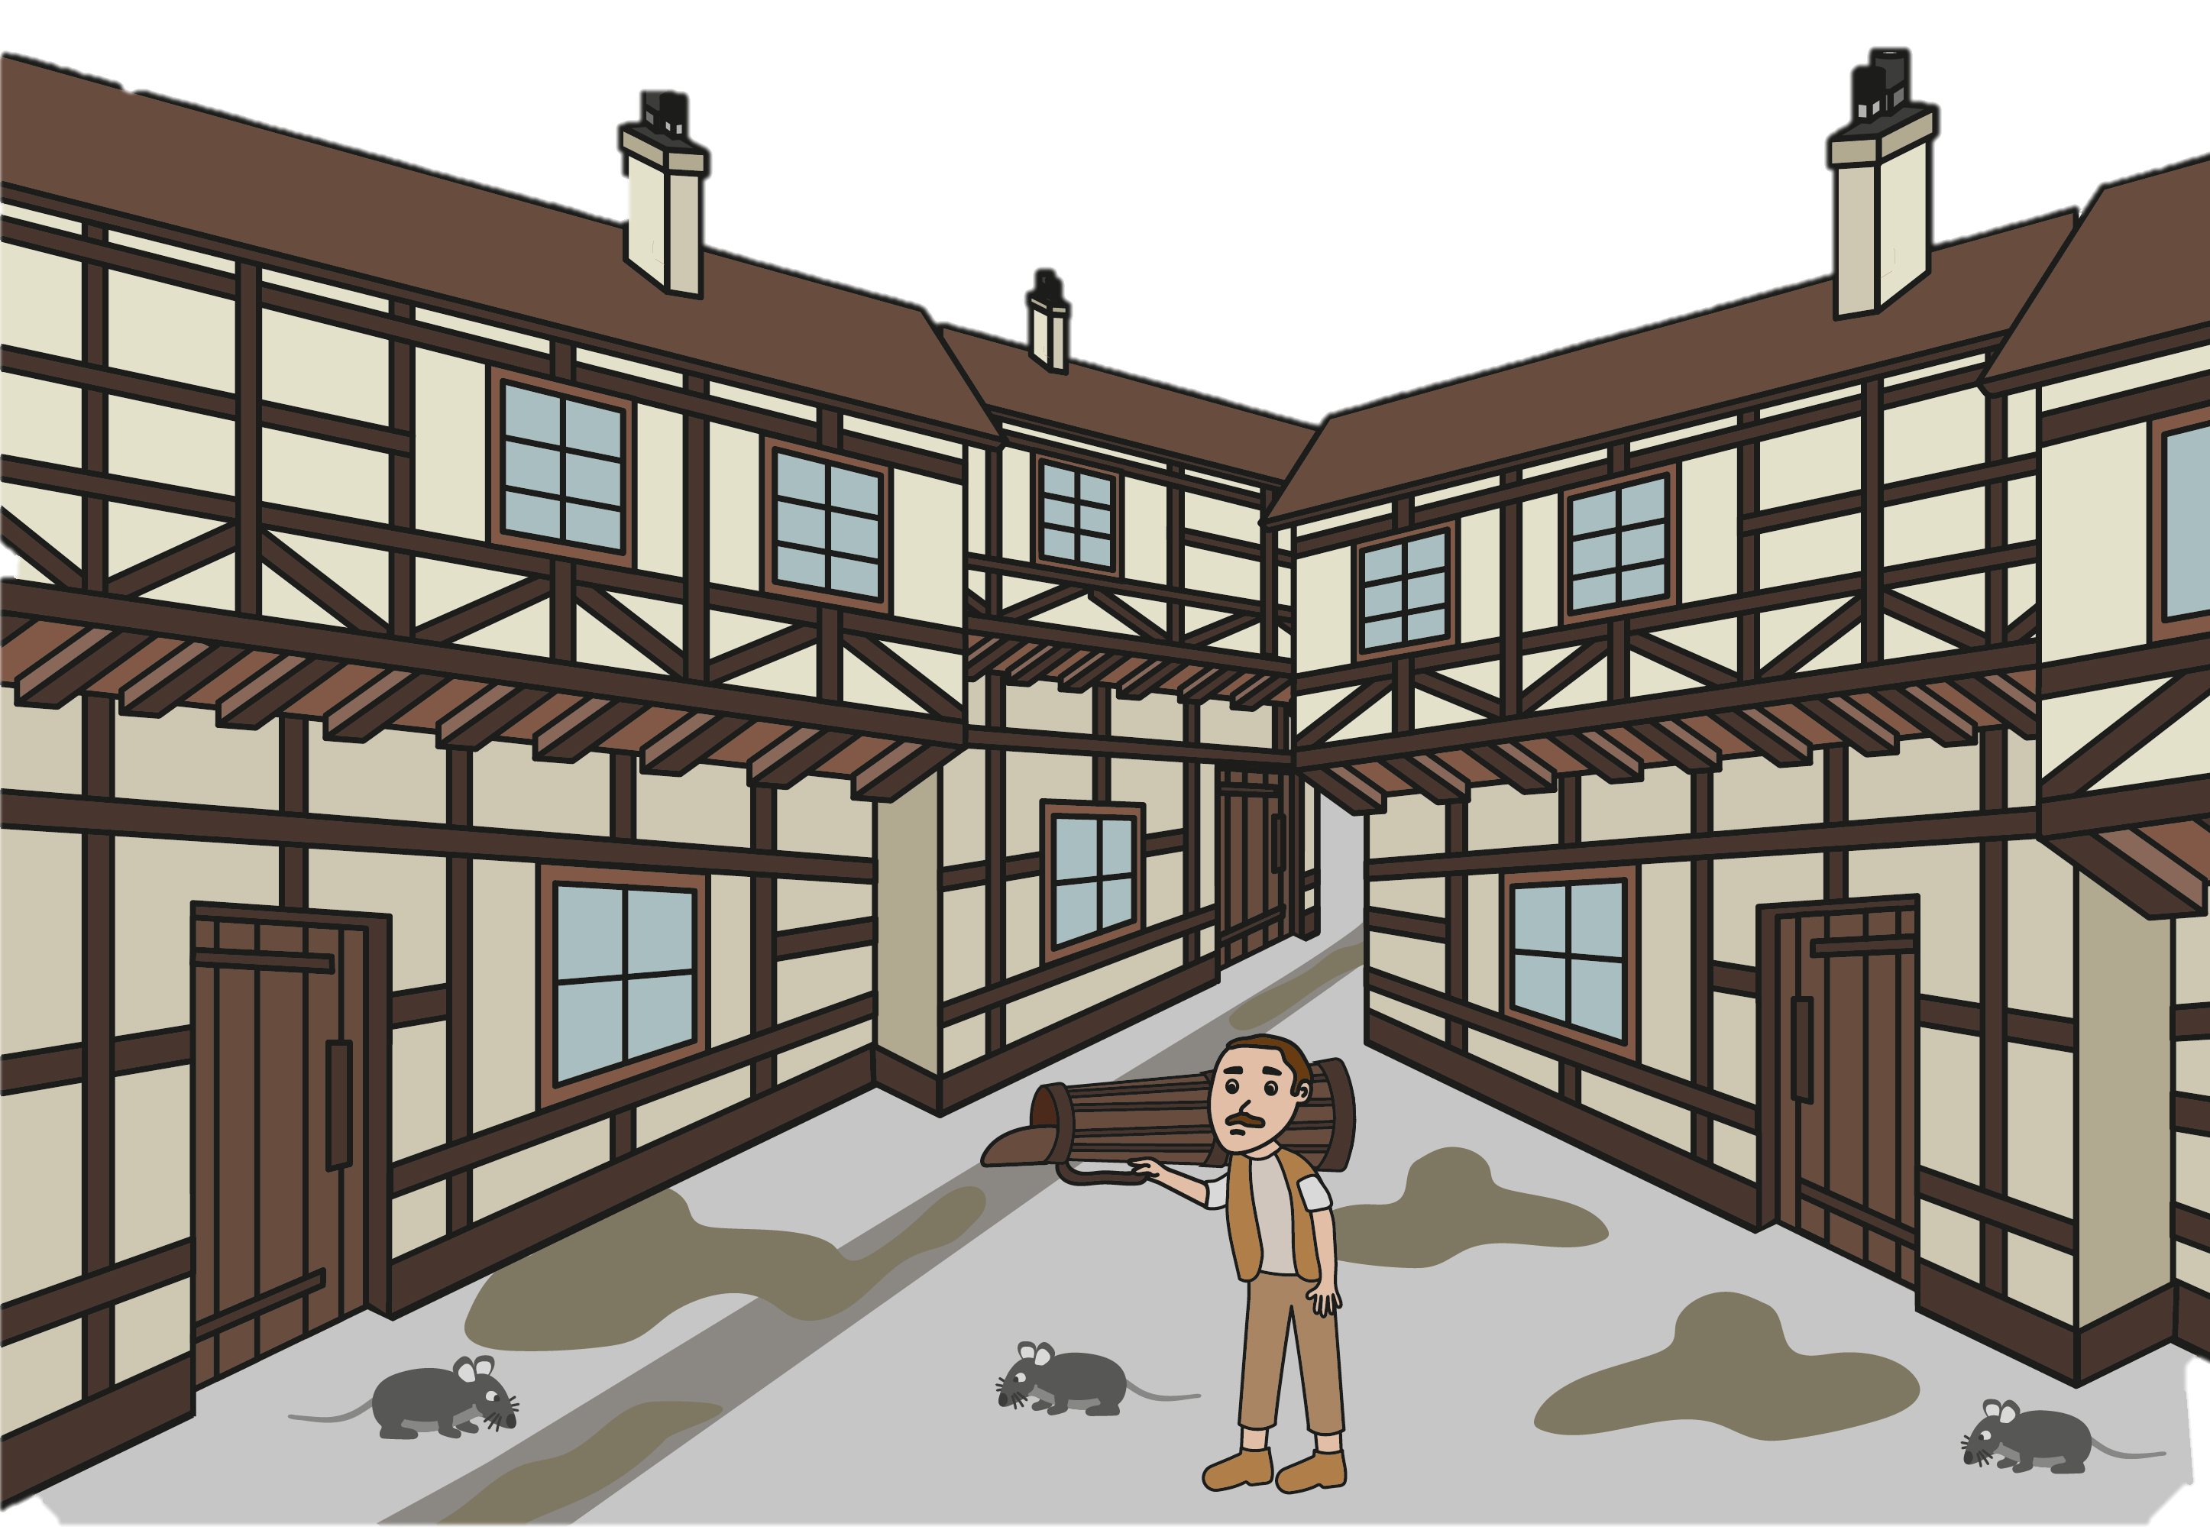
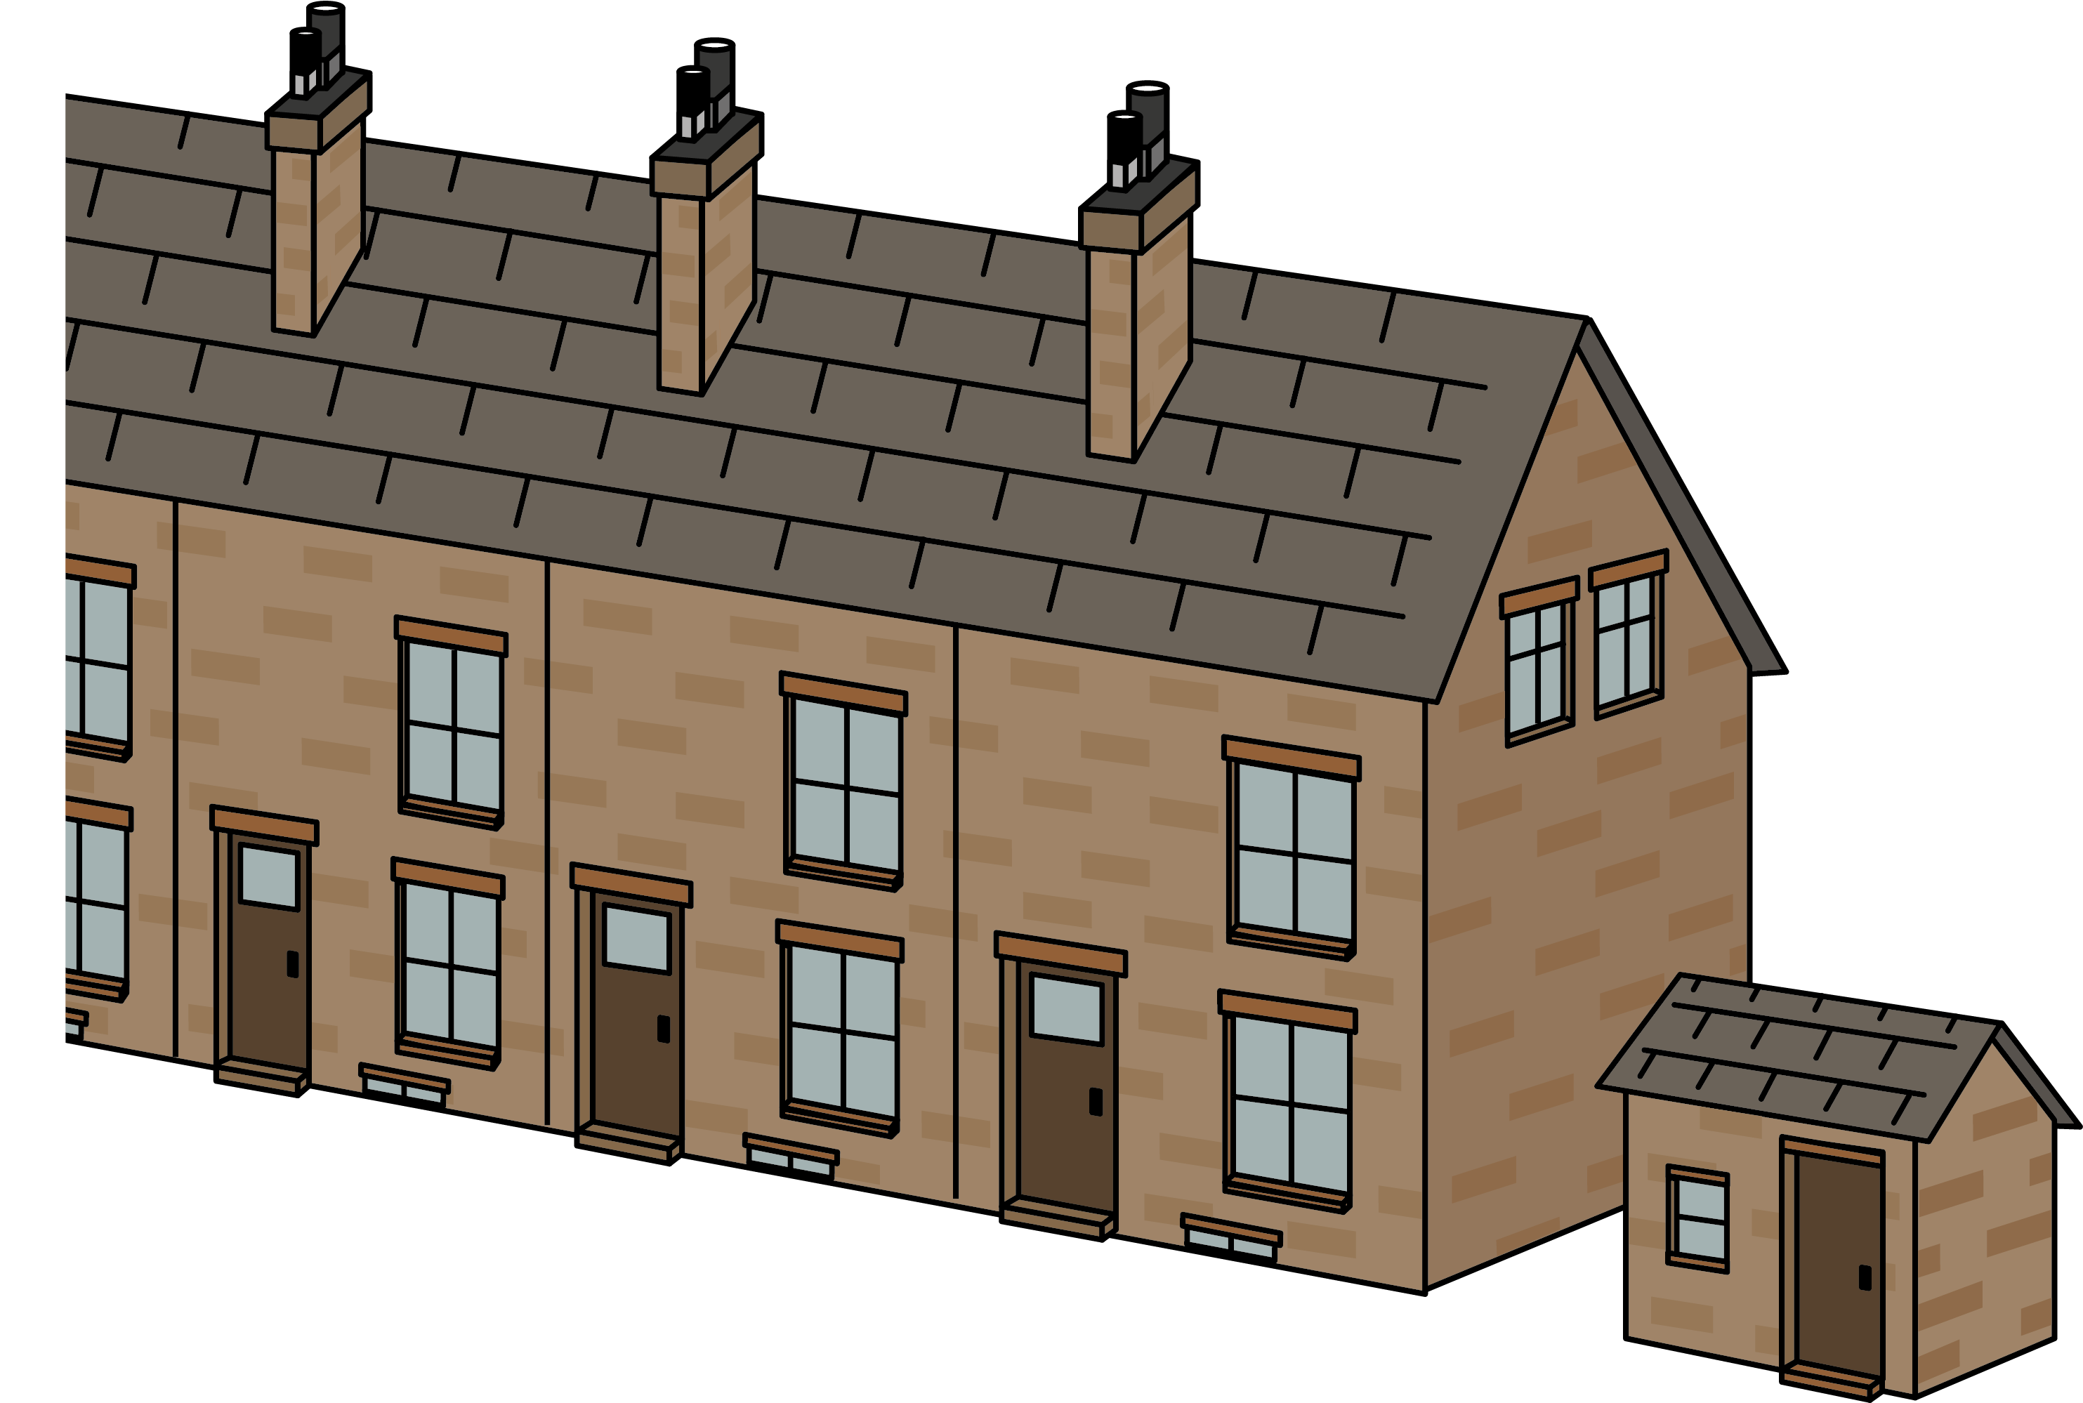
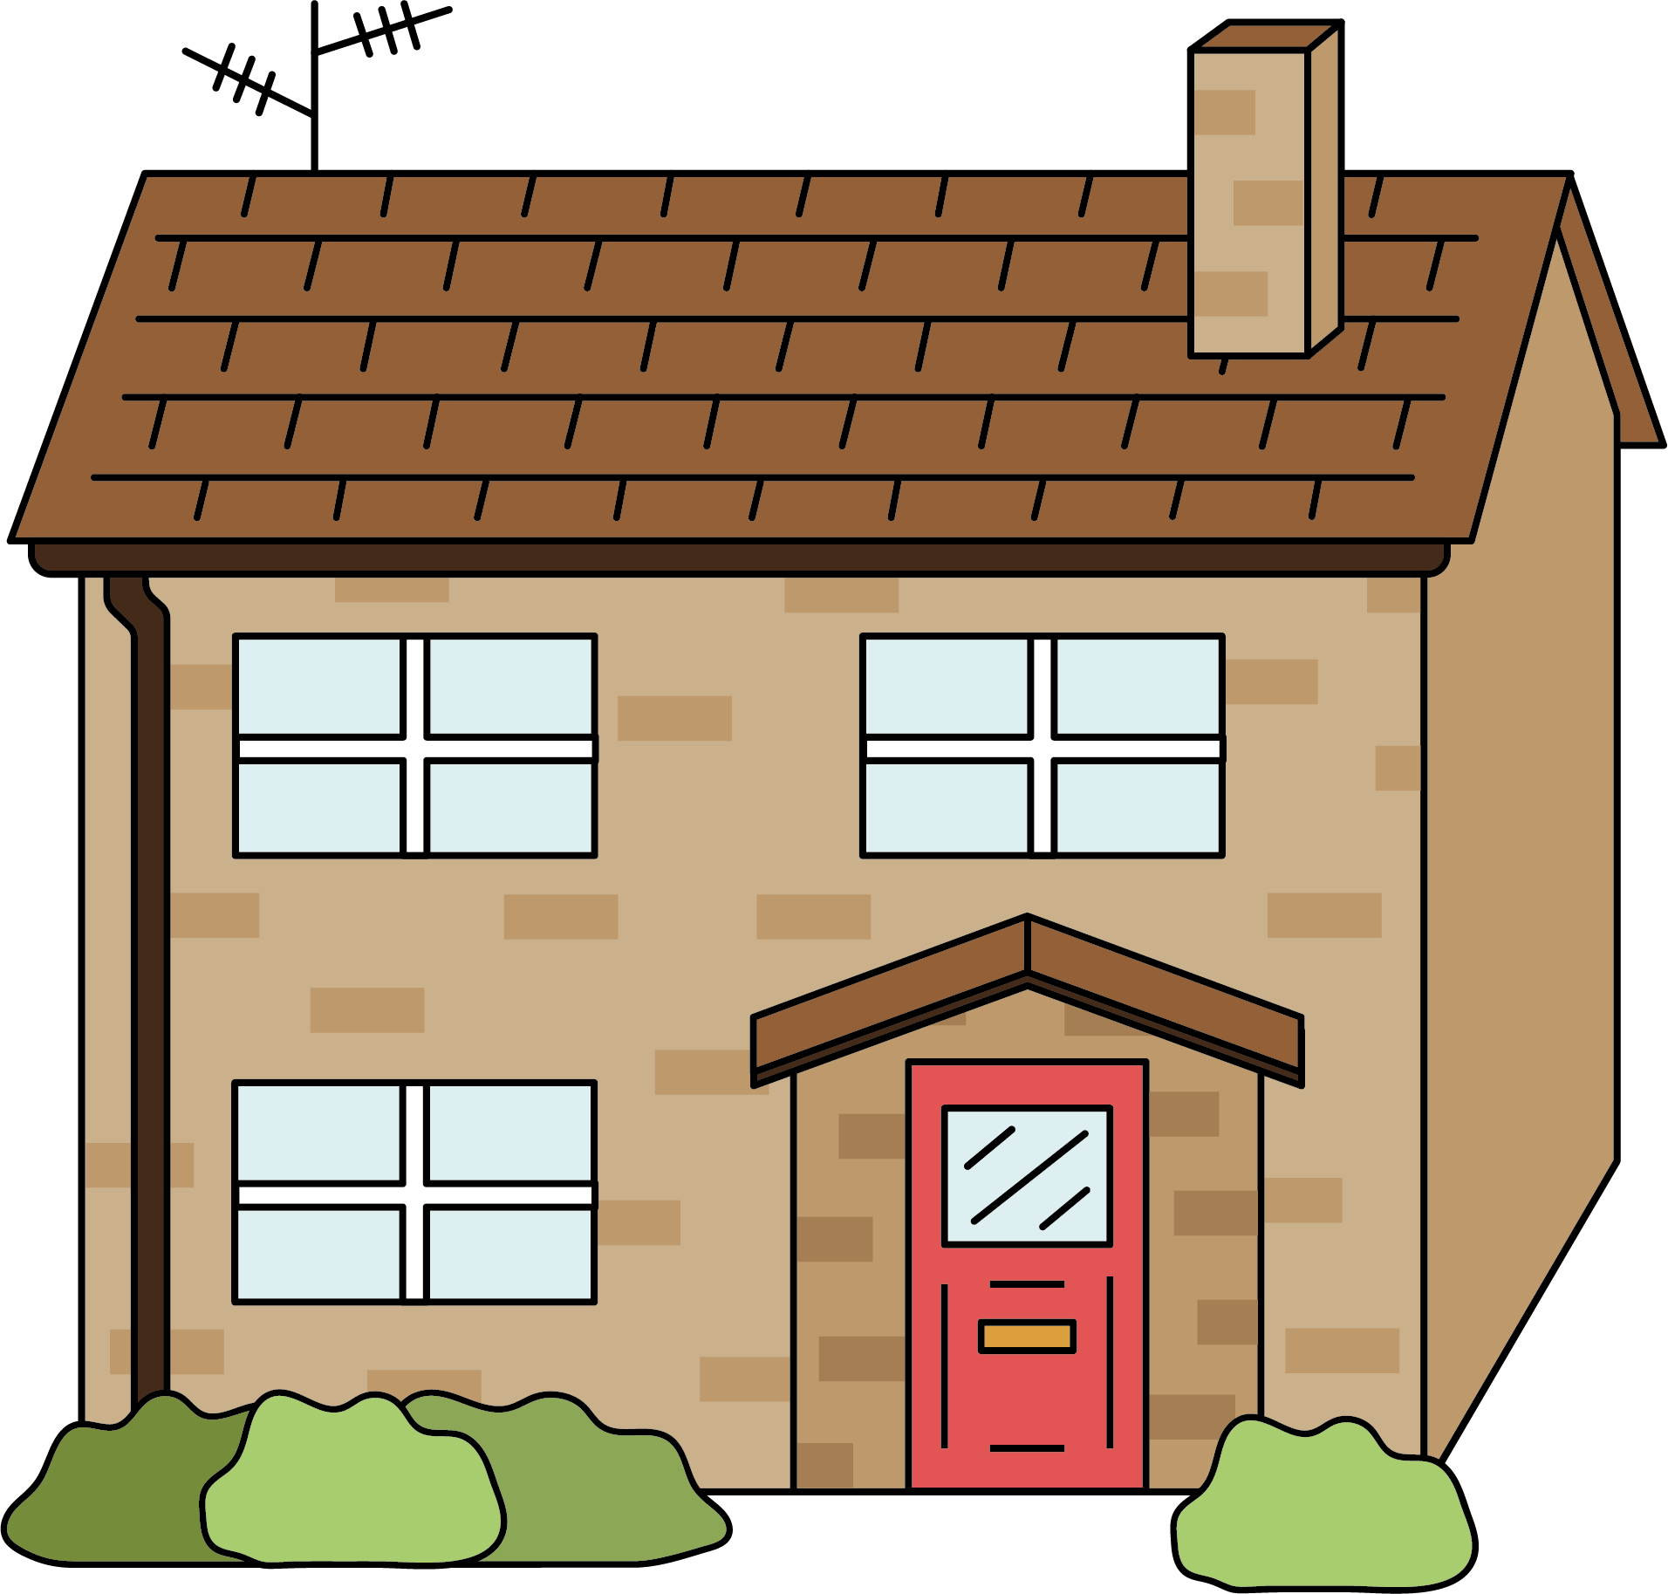
Homes through time
There are four versions of this knowledge organiser provided.
Teachers should choose the one(s) most appropriate for their pupils.
keep
motte
bailey
prehistoric
palisade
gatehouse
medieval
Tudor
Victorian
living memory
present
History | Year 1 – Summer Term | Knowledge Organiser
Notes:
Images: United Curriculum

Slide 2
Homes through time
In prehistoric, medieval and Tudor times, people went to the toilet in pots and then took it outside. There was no running water. Fires were very important to keep people warm.
keep
motte
bailey
palisade
gatehouse
prehistoric
medieval
Prehistoric roundhouses were made of wood and wattle and daub.
Motte-and-bailey castles were built to keep people safe.
They were built from wood and wattle and daub.
Tudor
Victorian
In Tudor houses, the upper floors stuck out. This is called jettying and gave more space.
They were built from wood and wattle and daub.
Back-to-back houses were built of brick and glass.
Shared toilets were outside, fires were important, and there was running water.
living memory
present
History | Year 1 – Summer Term | Knowledge Organiser
Notes:
Images: United Curriculum

Slide 3
keep
Homes through time
motte
bailey
palisade
gatehouse
Tudor
medieval
In Tudor houses, the upper floors stuck out. This is called jettying and gave more space.
They were built from wood and wattle and daub.
In prehistoric, medieval and Tudor times, people went to the toilet in pots and then took it outside. There was no running water. Fires were very important to keep people warm.
Motte-and-bailey castles were built to keep people safe.
They were built from wood and wattle and daub.
prehistoric
Victorian
Present
Prehistoric roundhouses were made of wood and wattle and daub.
Back-to-back houses were built of brick and glass.
Shared toilets were outside, fires were important, and there was running water.
living memory
History | Year 1 – Summer Term | Knowledge Organiser
Notes:
Images: United Curriculum

Slide 4
Homes through time
keep
motte
bailey
palisade
gatehouse
medieval
Tudor
prehistoric
Victorian
Present
living memory
History | Year 1 – Summer Term | Knowledge Organiser
Notes:
Images: United Curriculum

